Slide 1
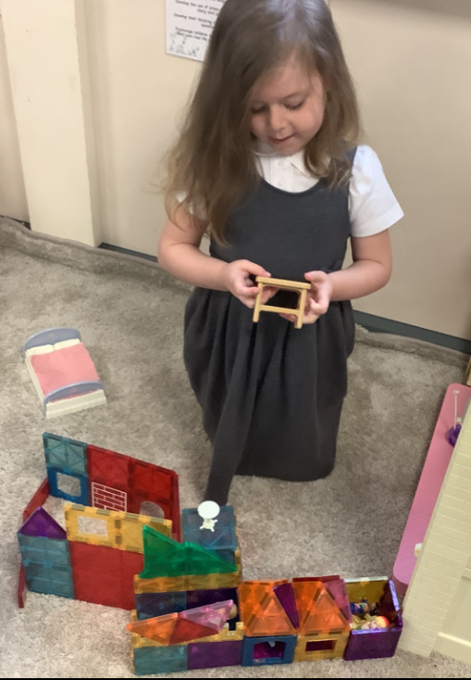
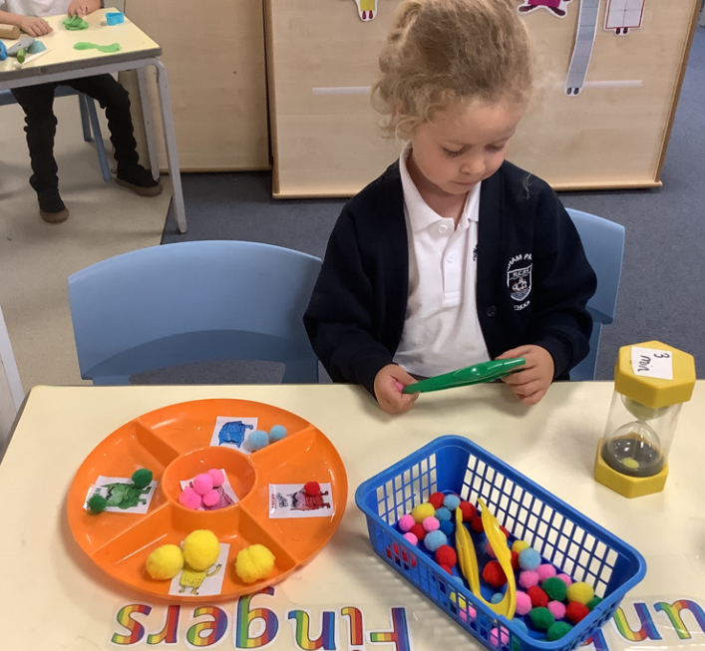
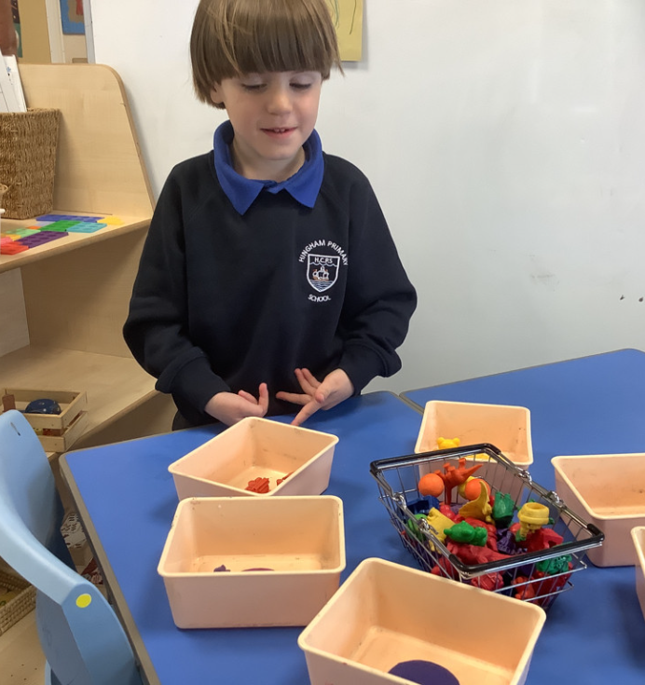
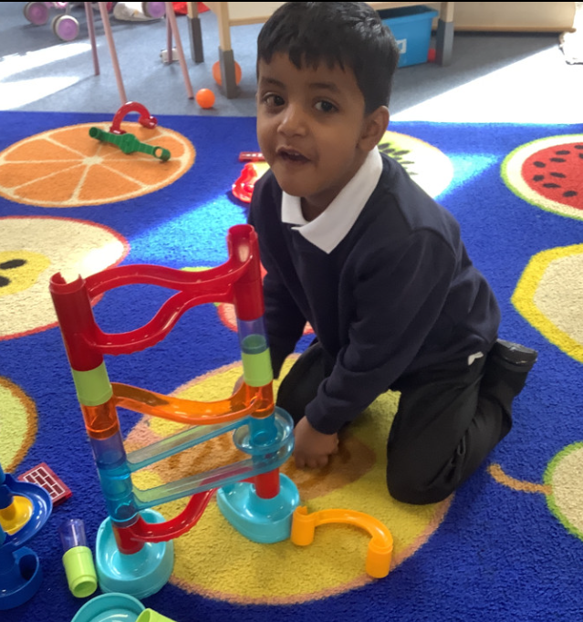
Butterfly Class Newsletter
05.09.25
It’s been such an exciting week in Butterfly Class. We have really enjoyed getting to know the children and helping them explore the classroom. We are really looking forward to having them altogether next week. On a Thursday morning the class will be taught by Miss Flowers. After half term she will teach P.E (more details on P.E. kit will follow soon).
Water bottles and snacks:
Please ensure children come to school with water in their bottles. We also ask that children bring only fruit and vegetables in for their snack, we are a nut free school as we have several children in school with nut allergies. Often cereal bars and packet can contain traces of nuts, which is why we ask for fruit and vegetables only.
Labels:
Please ensure everything is labelled. We try our very best not to lose any of the children’s belongings but this is made easier if things are labelled. Items like jewelery are hard to keep track of so we ask that these sorts of things stay at home.

