Slide 1
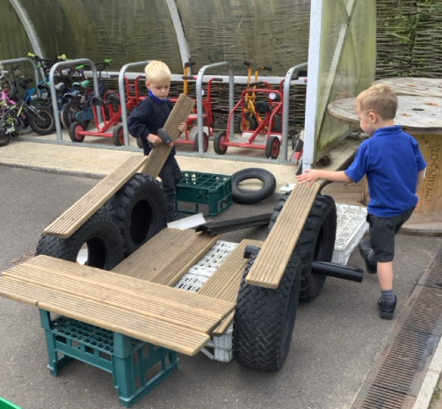
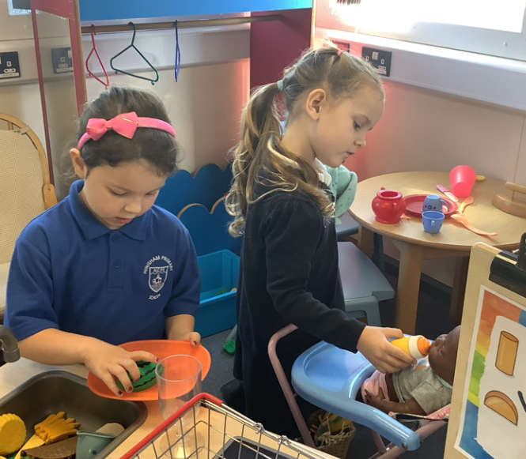
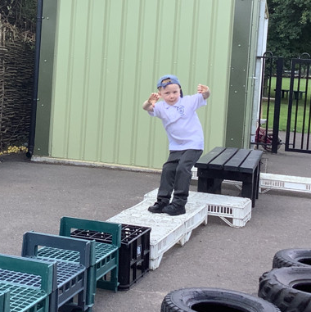
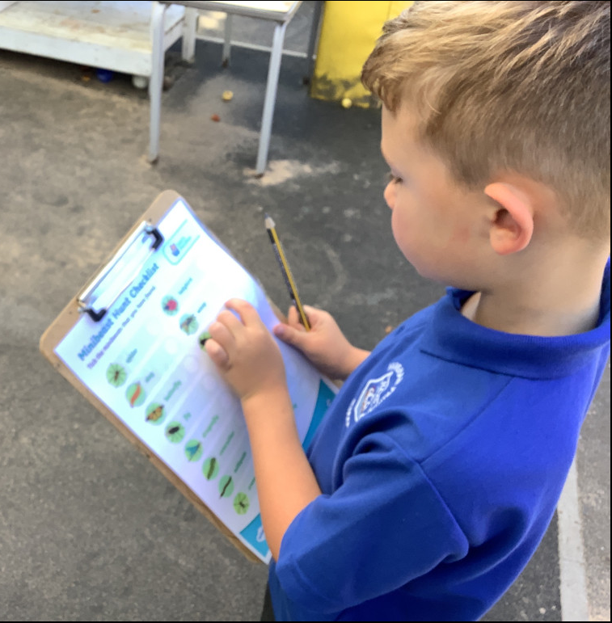
Butterfly Class Newsletter
12.09.25
We have had another fantastic week in Butterfly Class. The children have been really getting into the new routines of school and have been growing in confidence with the lunchtime routine. We have been playing lots of getting to know you games and the children have been enjoying getting to find out a bit more about each other.
Independence:
We are working really hard on independence skills with the children. We are focusing on independent toilet skills, including being able to do their own buttons after using the toilet. We are also encouraging children to put on and take off their jumpers. It would be greatly appreciated if these skills could be practised at home as well.
Helmets and Wellies:
We are still missing a few wellies and helmets. We are out on the field in all weathers so named wellies are an essential and without a helmet children will be unable to go on the bikes.

