Slide 1
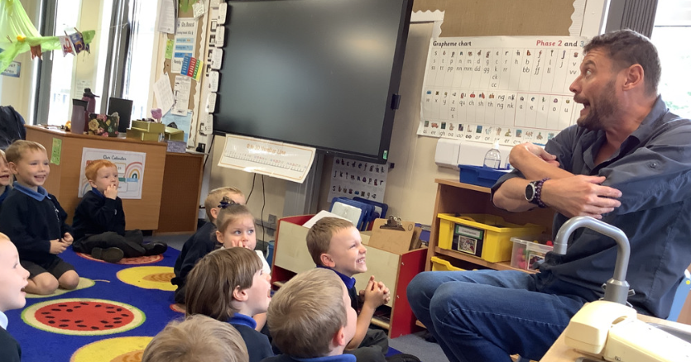
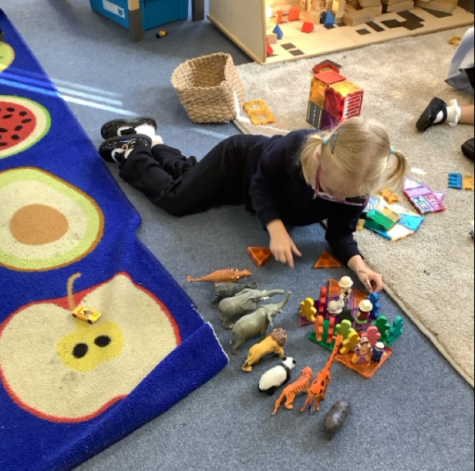
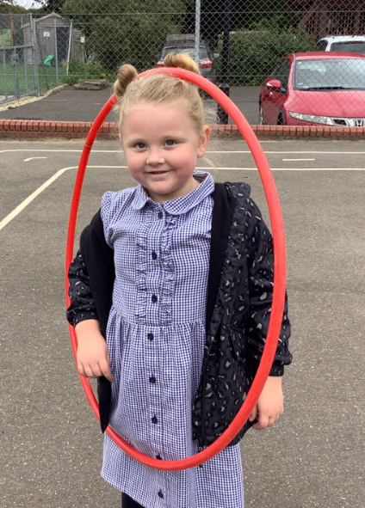
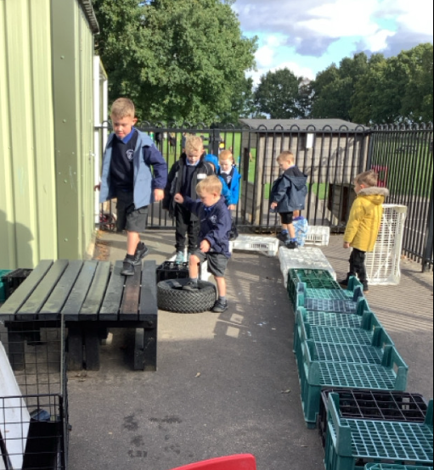
Butterfly Class Newsletter
26.09.25
This week has been another fantastic week in Butterfly Class. We were lucky enough to have an author visit at the beginning of the week. The children enjoyed listening to him tell some of his stories and enjoyed asking questions about his books. We are so proud of how they listened and engaged.
Independence:
As the colder weather is approaching we are encouraging the children to have a go at putting on their coats and zipping them up. I know it can be busy getting out of the door but please try as much as possible to make the children have a go themselves first. A struggle is sometimes a good thing.
Labelling:
We are ending up with quite a few bits of lost property. Please ensure everything sent to school is labelled, we try our best to return items to their owners but labels really help.

