Slide 1
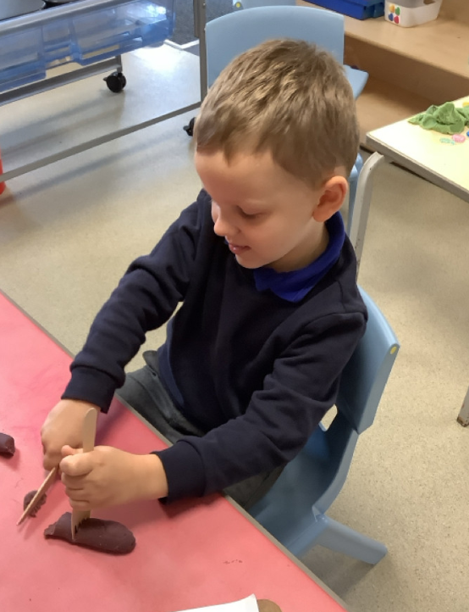
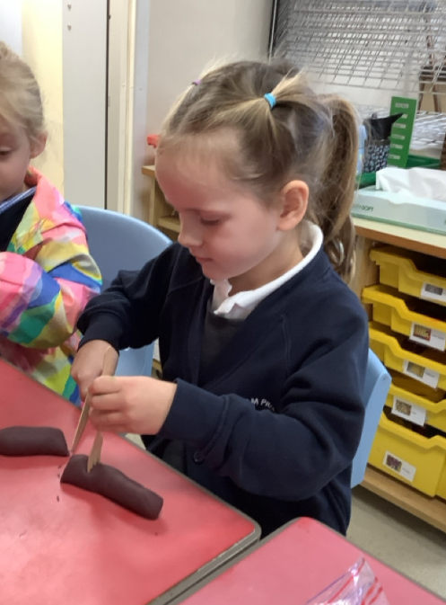
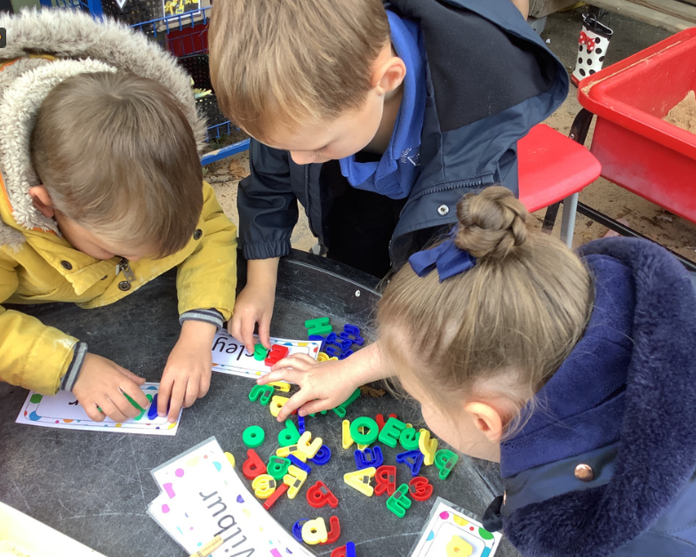
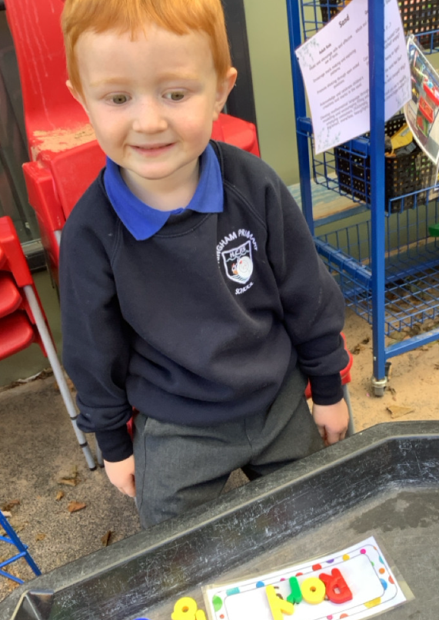
Butterfly Class Newsletter
03.10.25
We’ve had another fabulous week in Butterfly Class. This week the children have been practising their cutlery skills in the hall at lunchtime as well as in the classroom. They have been using the playdoh and rolling it into sausages. They are then practising cutting their sausage using a knife and fork. If you’ve got any playdoh at home this is a fantastic way to build up their muscles in their hands as well as being fun and takes the pressure away of trying to encourage it at mealtimes.
Welly Walk Week:
Next week is welly walk week. The children will wear their wellies on the field at lunchtime. Children are able to wear funky coloured socks to school and then change into their wellies at lunchtime.
Independence:
As a parent I know how stretched time can be in the mornings when children are getting ready for school but please as much as possible encourage children to have a go at getting themselves dressed first. This will help them hugely with their independence at school.

