Slide 1
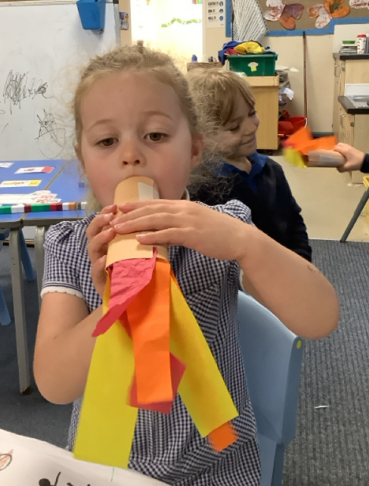
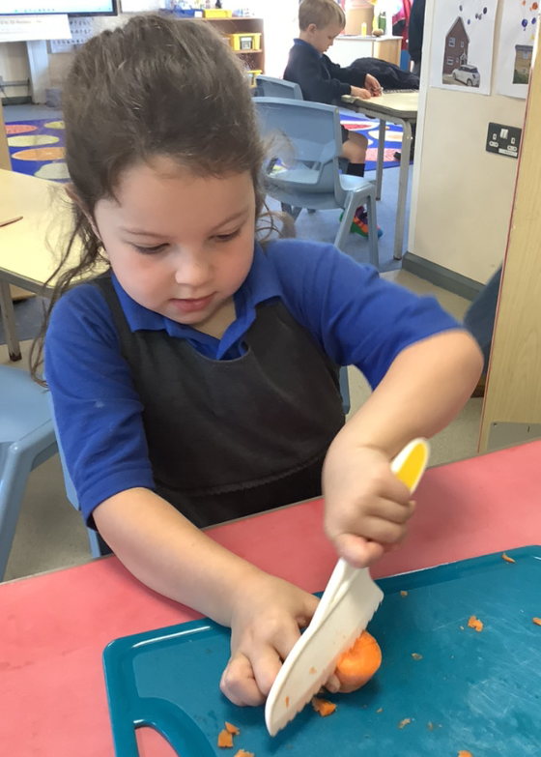
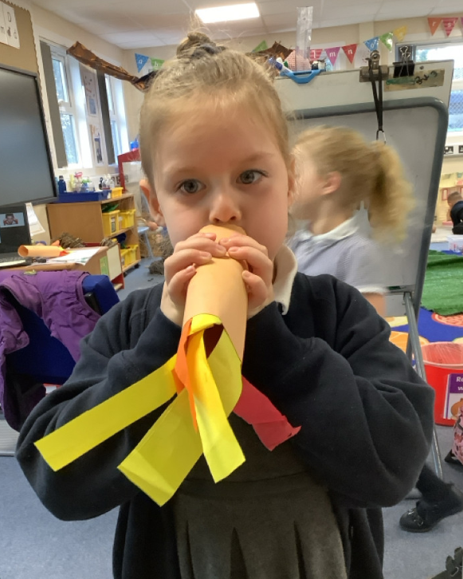
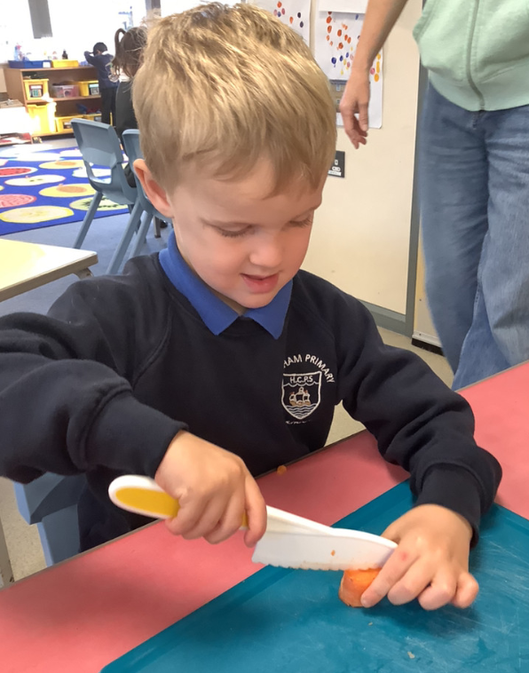
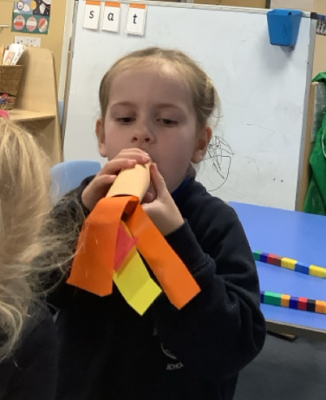
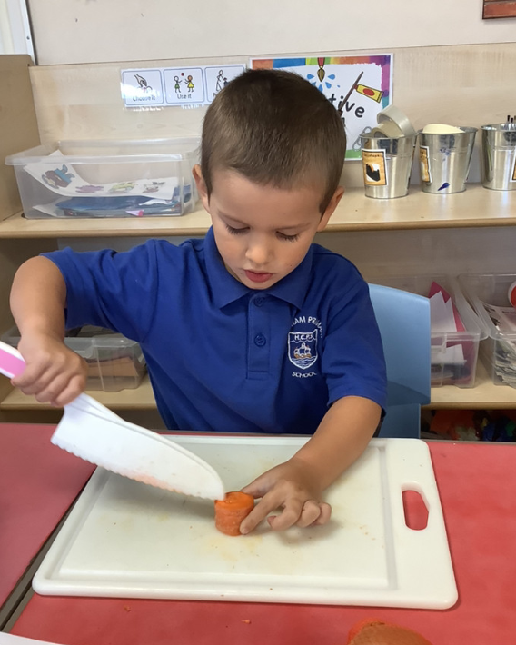
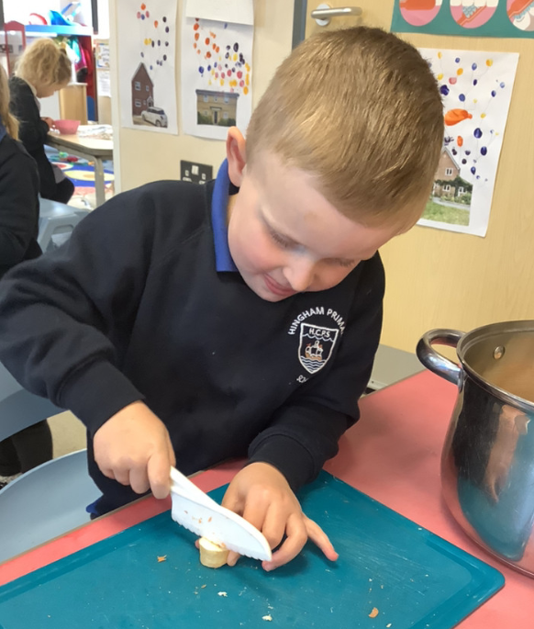
Butterfly Class Newsletter
10.10.25
We’ve been feeling very Autumnal this week in Butterfly Class. We have been learning about Harvest Festival and used this opportunity to make our own vegetable soup. The children worked incredibly hard to chop the carrots and parsnips (which even Miss Gooch found tricky). Some children then tasted the vegetable soup and decided it was delicious. We also enjoyed an Autumn welly walk around the field. We talked about the leaves on the trees changing colour and falling off the trees. The children really enjoyed crunching and throwing the leaves.
Practising Sounds:
The children have been given sound cards of some of the phonemes we have learnt so far. When you are practising these at home with your child please make a note in their communication book and we will give them a sticker for their hard work.
Independence:
As a parent I know how stretched time can be in the mornings when children are getting ready for school but please as much as possible encourage children to have a go at getting themselves dressed first. This will help them hugely with their independence at school.

