Slide 1
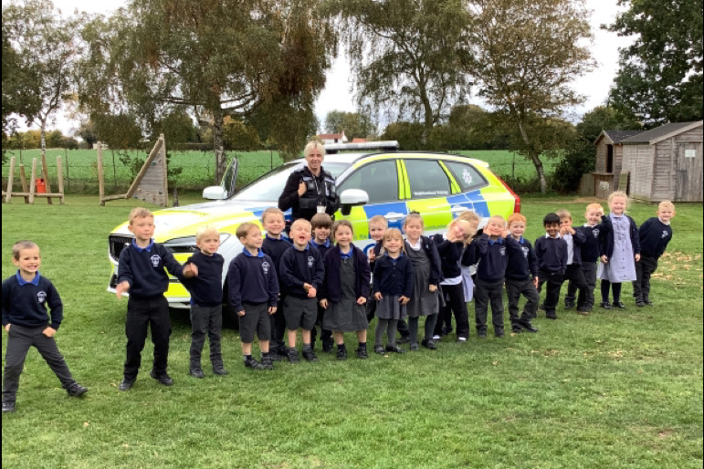
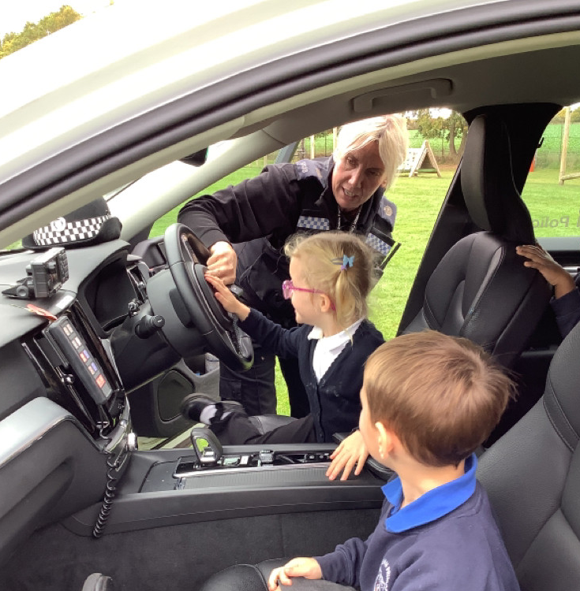
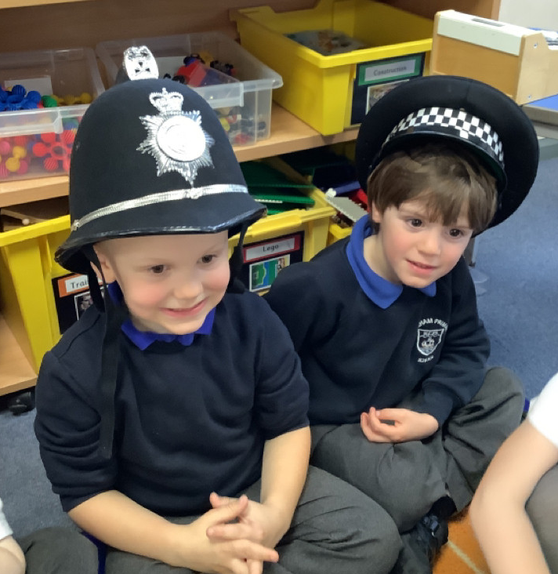
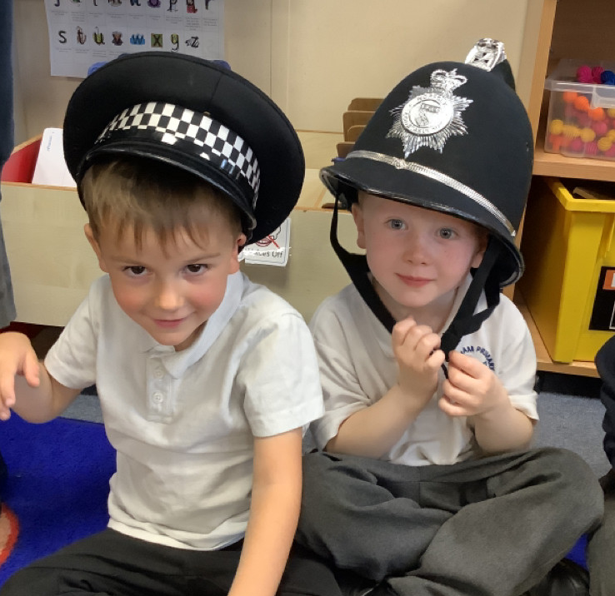
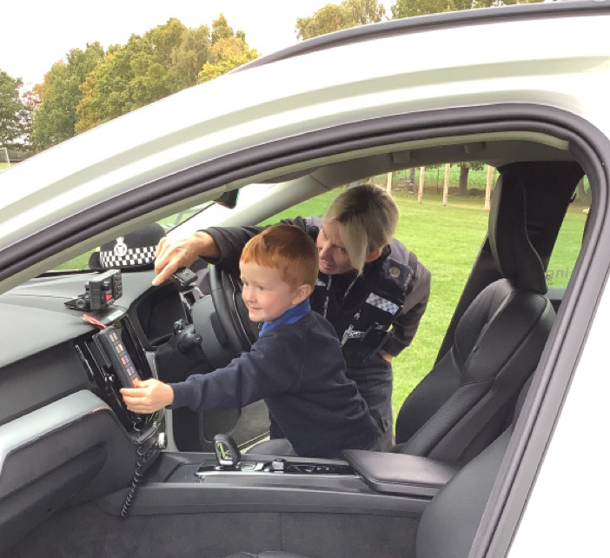
Butterfly Class Newsletter
17.10.25
This week it’s been all about ‘People Who Help Us’. The week started in very exciting fashion as we had a visit from a police officer. They talked to the children about their job and how they keep people safe. The children were lucky enough to get to sit inside the police car and were even allowed to switch on the lights and the siren. On Wednesday we had another visit from a familiar face who told the children all about their job as a biomedical scientist. If anyone else would like to come in and talk to the children about their job it would be greatly appreciated.
Practising Sounds:
The children have been given sound cards of some of the phonemes we have learnt so far. When you are practising these at home with your child please make a note in their communication book and we will give them a sticker for their hard work.
Independence:
As a parent I know how stretched time can be in the mornings when children are getting ready for school but please as much as possible encourage children to have a go at getting themselves dressed first. This will help them hugely with their independence at school.

