Slide 1
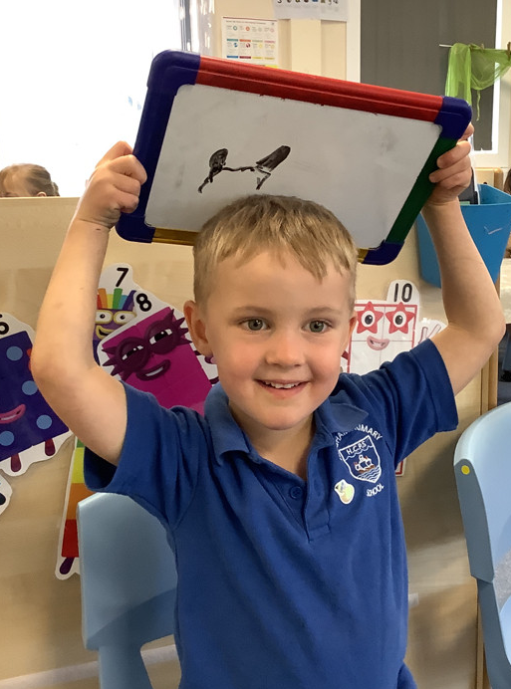
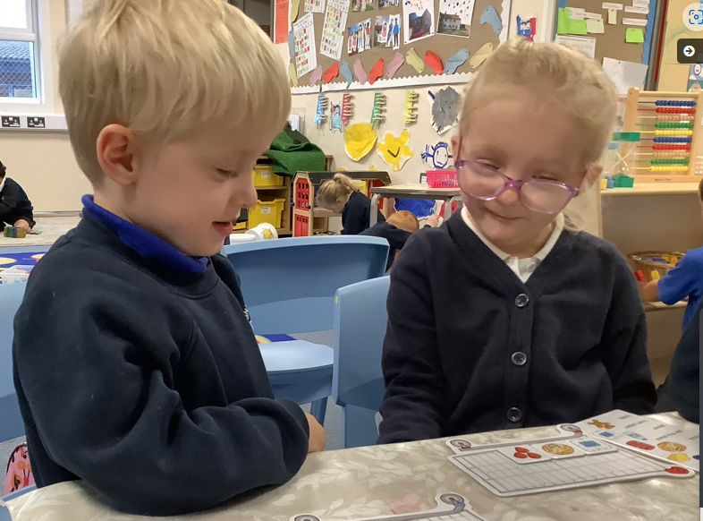
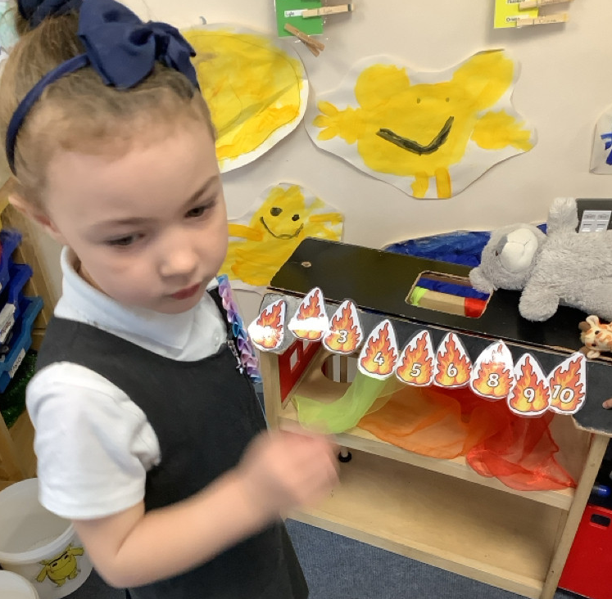
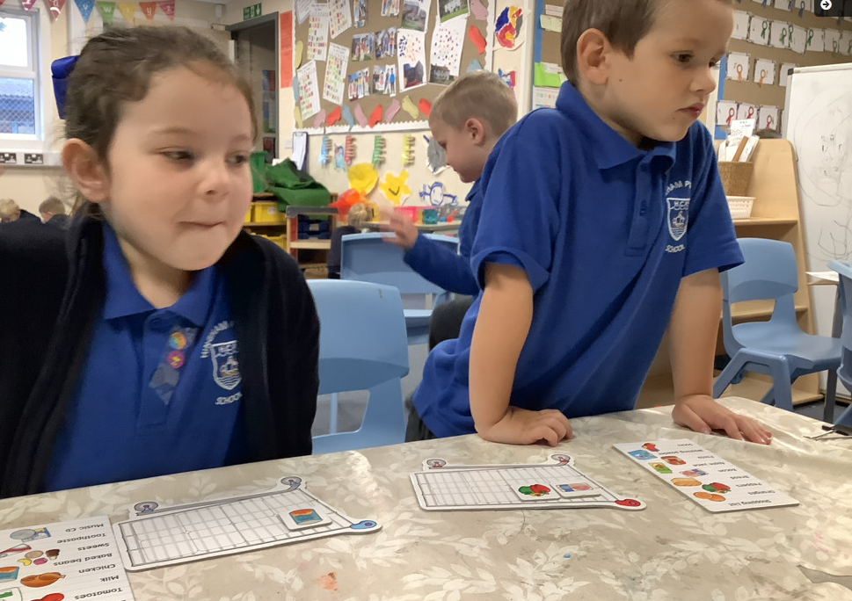
Butterfly Class Newsletter
24.10.25
Wow! I cannot believe we have completed the first half term in Butterfly Class. We are so proud of how well the children have settled in to school life and how much progress they have already made. They have earnt themselves a well deserved rest over half term so they are ready to go for the always busy half term before Christmas. See you at 8:45 on 3rd November.
Key dates for next half term:
5th November, Little City visit (nothing required for this).
6th November, school photo day
Parents evening week of 10th November.
18th November, height and weight check
3rd December, Nativity performance in the church (more information to follow).
5th December, Friends Christmas Shopping event (more information to follow).
15th December, whole school trip to the pantomime.

