Slide 1
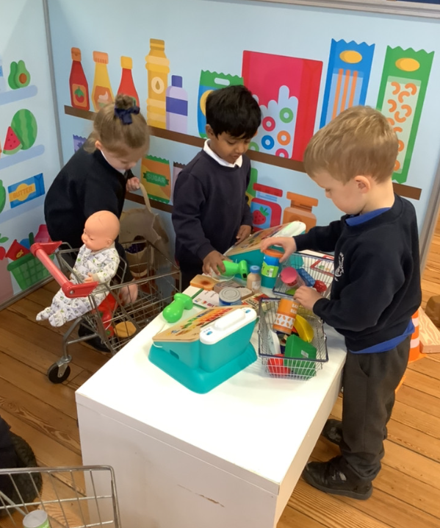
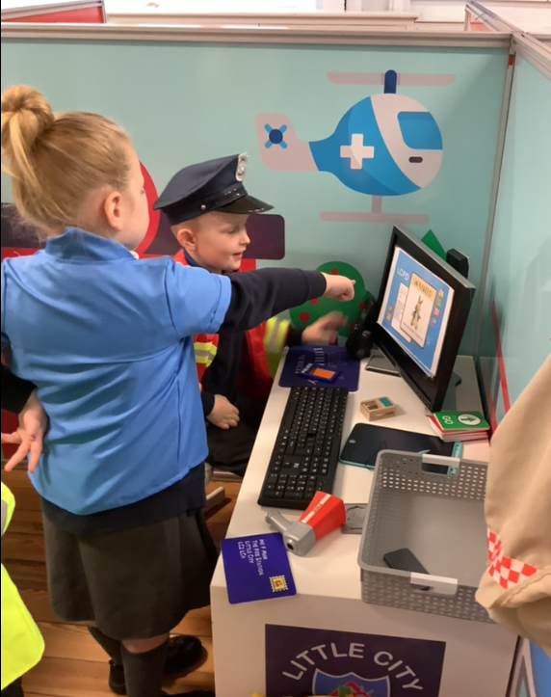
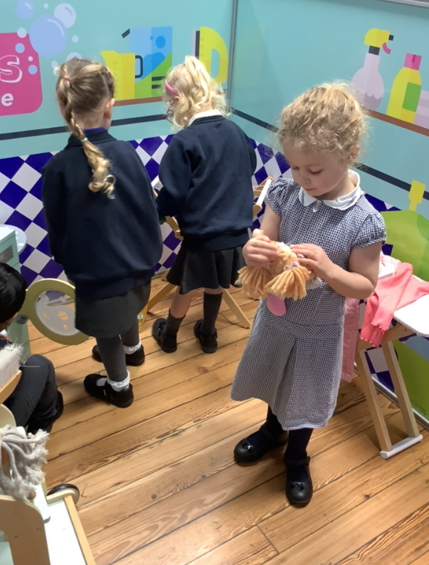
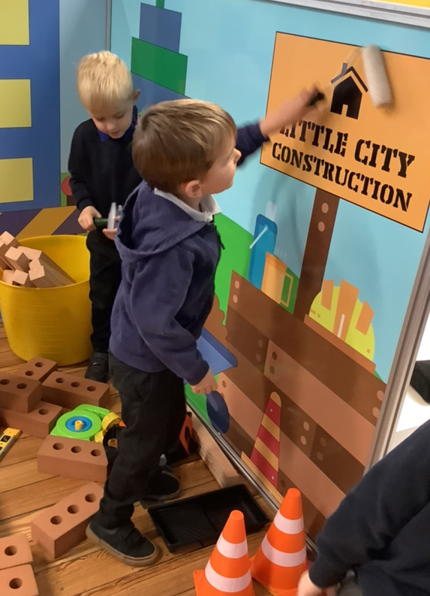
Butterfly Class Newsletter
07.11.25
The children have settled straight back into our school routines. We had such a lovely morning on Wednesday when we had a visit from Little City. The children really enjoyed exploring all the different areas and played beautifully together. The lady running the event couldn’t believe how settled they were and how nicely they played. She couldn’t believe they had only been at school for 8 weeks. We are really proud of them.
Helmets:
Please make sure your child has their helmet in school. Weather permitting we will try to still get out on them at least once a week.
Sound cards:
Please continue to practise recognising the sounds we have learnt so far. The ones children are confident with can also be used to create words e.g. sat, pat, pin.

