Slide 1
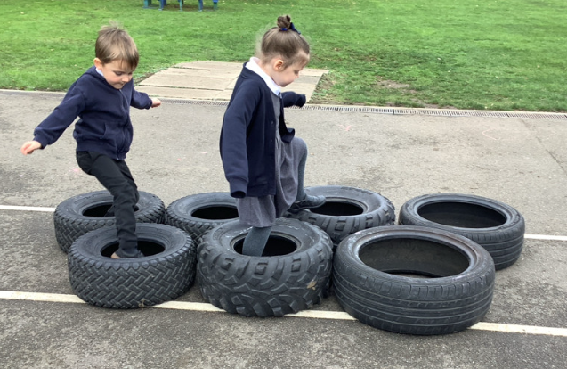
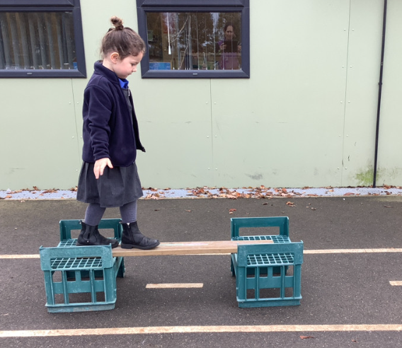
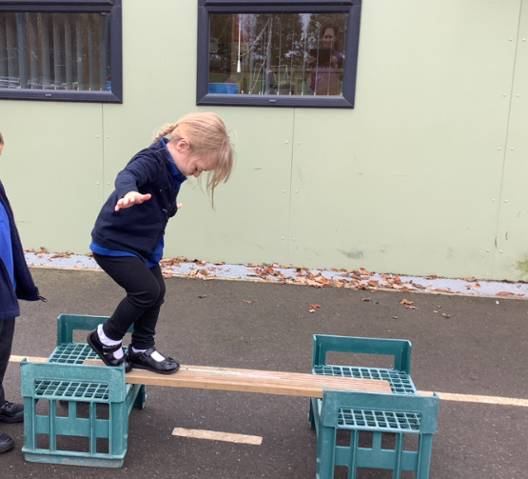
Butterfly Class Newsletter
14.11.25
This week we have spent a lot of time talking to the children about Remembrance and why we wear poppies at this time of year. The children have talked really sensitively around this and we have been really impressed with how they have listened. We are so proud of how well they did on Tuesday during the two minute silence. As part of our Remembrance activities Mrs Wood led an army day last Friday. The children got really stuck in and enjoyed their army training.
P.E
In a couple of weeks children will be starting P.E lessons on a Thursday morning. On these days children can come into school in:
Colour team t-shirt (same colour as communication book).
Joggers
Trainers
I will send a parentmail with the exact date this will start.
Sound cards:
Please continue to practise recognising the sounds we have learnt so far. The ones children are confident with can also be used to create words e.g. sat, pat, pin.
Nativity:
As part of this years Nativity, Butterfly Class will be taking on the role of angels. We are able to provide a costume for your child for this.

