Slide 1
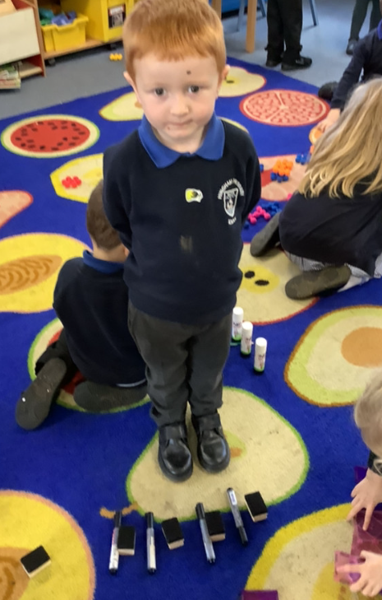
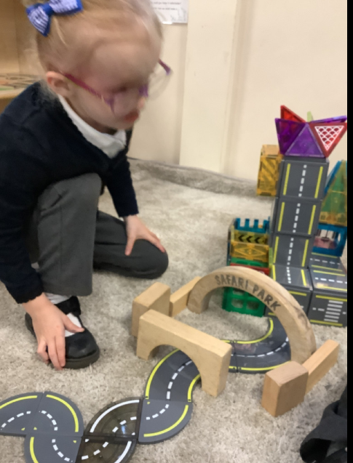
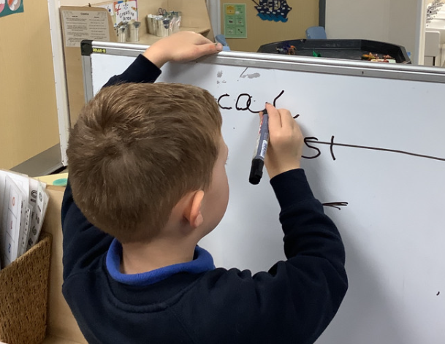
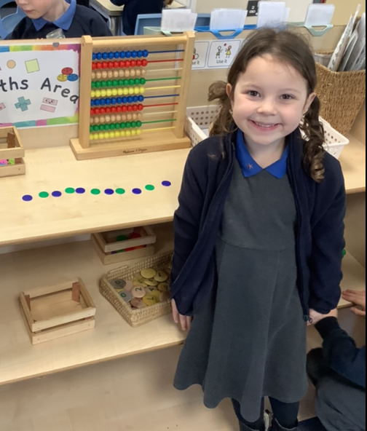
Walkers to the church:
As part of the Nativity we will be walking to the church to rehearse. If anyone can help us walk on the mornings of 2nd and 3rd December it would be hugely appreciated. Just let one of us know.
Butterfly Class Newsletter
21.11.25
P.E
In a couple of weeks children will be starting P.E lessons on a Thursday morning. On these days children can come into school in:
Colour team t-shirt (same colour as communication book).
Joggers
Trainers
I will send a parentmail with the exact date this will start.
Sound cards:
Please cut out the sound cards at home. We are working hard on blending to read words at school. The cards can be used at home to make words e.g. leg, cat and fan.
Nativity:
This year the Nativity will take place in the church on Wednesday 3rd December. We would love to see all the children there but if your know your child is unable to attend please let us know so we can organise costumes.

