Slide 1
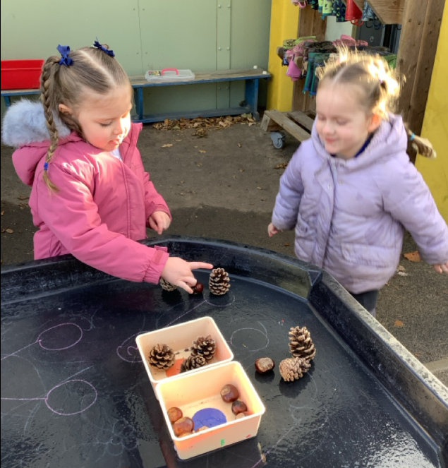
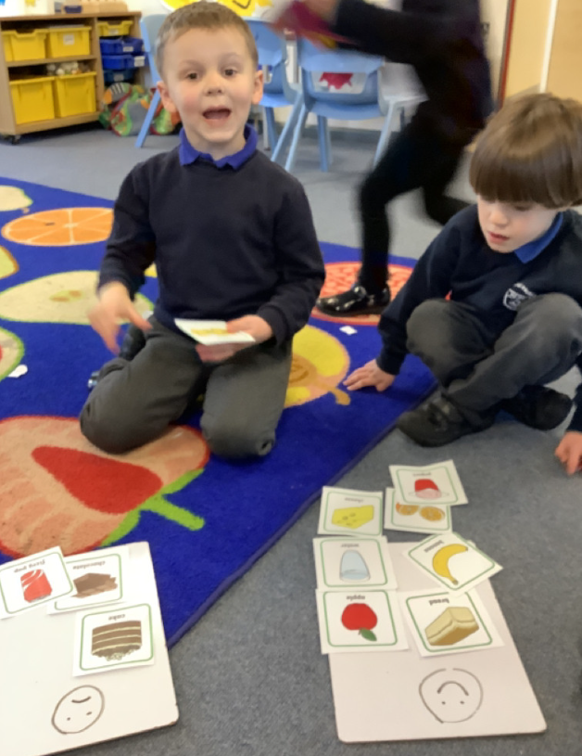
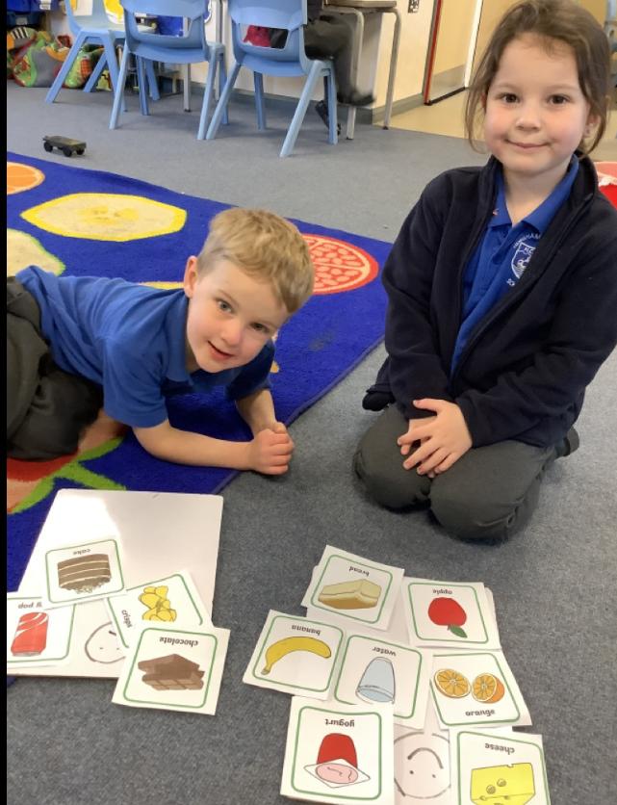
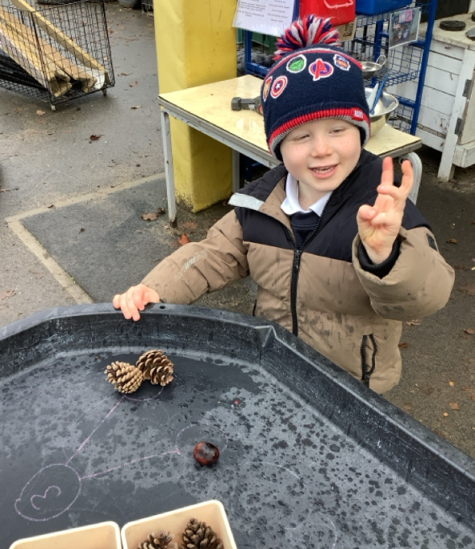
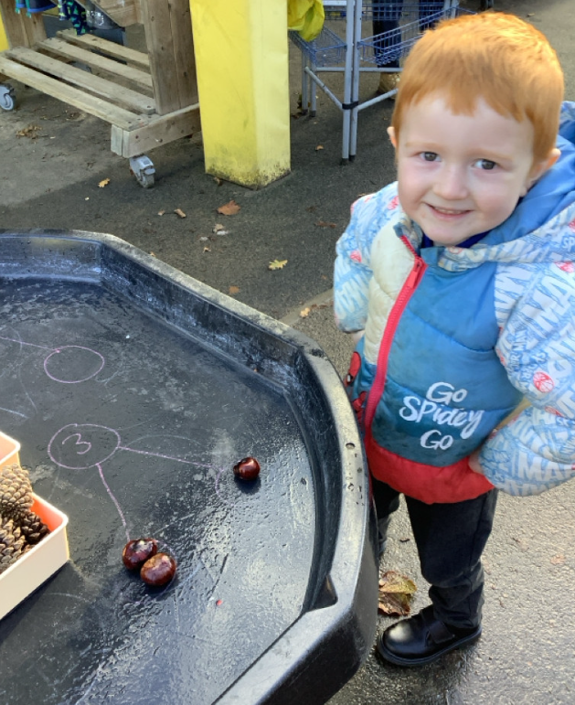
Butterfly Class Newsletter
28.11.25
This week the children have been learning about numbers up to 3. The children have been working on subitising (which is counting by looking). We have also been looking at the different ways 3 can be made. The children have been making 3 with conkers and pine cones. They have also spent some time learning about healthy and unhealthy food choices. Thank you to all those who attended phonics workshop. We will be sending home the handout for those who couldn’t make it.
Nativity info:
Tuesday and Wednesday morning we will be walking to the church. We will leave school at about 9:30. The performance on Wednesday evening will be in the church at 5:30pm. Butterfly children will need to arrive at 5pm so we can dress them. A member of staff will be at the church door and bring them to us, as parents are unable to enter the church before 5:30pm.
December:
December can be such a busy time that impacts routines both at home and school. To help ease this I have created a visual timetable for the events that will be happening at school. Please see this attached on the next page.

Slide 2


