Slide 1
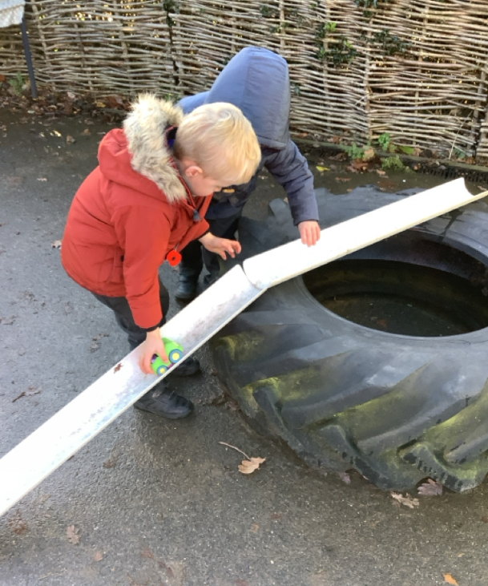
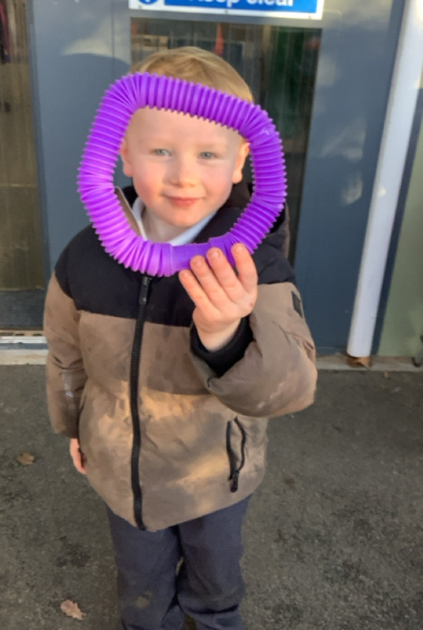
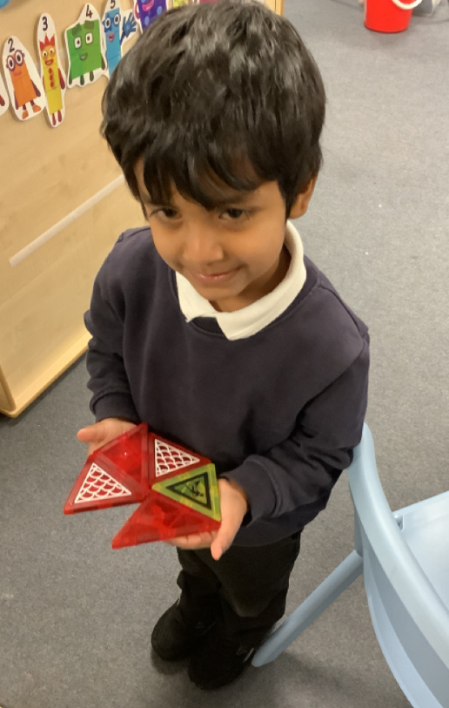
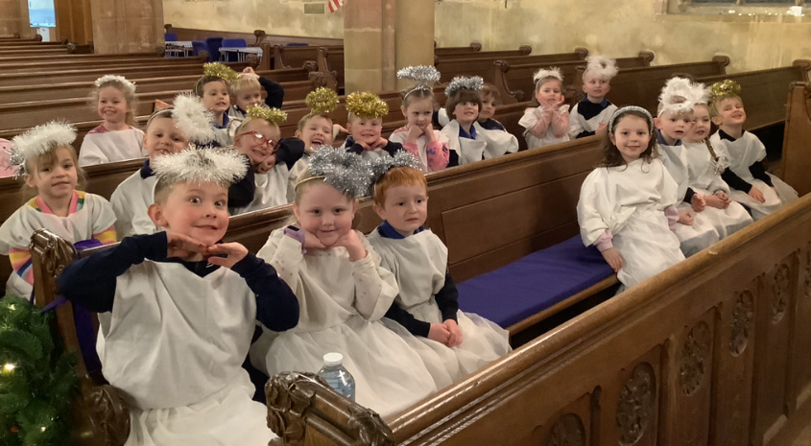
Butterfly Class Newsletter
05.12. 25
Wow!! What a week! We are so proud of how well the children walked to the church on Tuesday and Wednesday morning. Thank you to everyone who helped us walk there and back. We are also impressed with how incredibly well they did on Wednesday night, they sang beautifully and were wonderful angels. Thank you to everyone who attended. We’ve got a few busy weeks ahead of us so please use the calendar on the next page to keep up to date with what is happening each day.
Spare clothes:
We are running low on spare clothes (especially trousers). Please make sure your child has a set of spare clothes at school and if you have had some school spares, please can they be returned.

Slide 2


