Slide 1
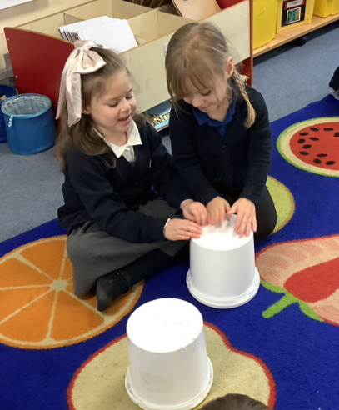
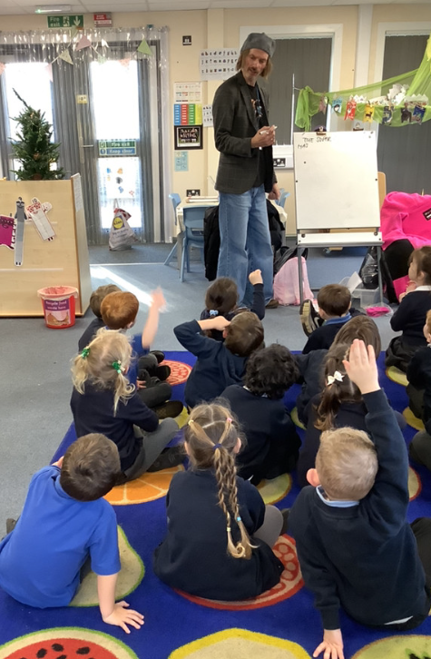
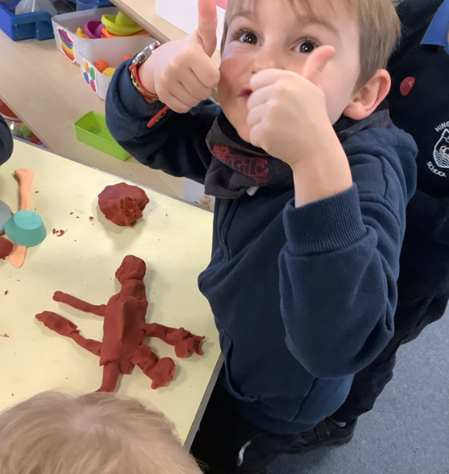
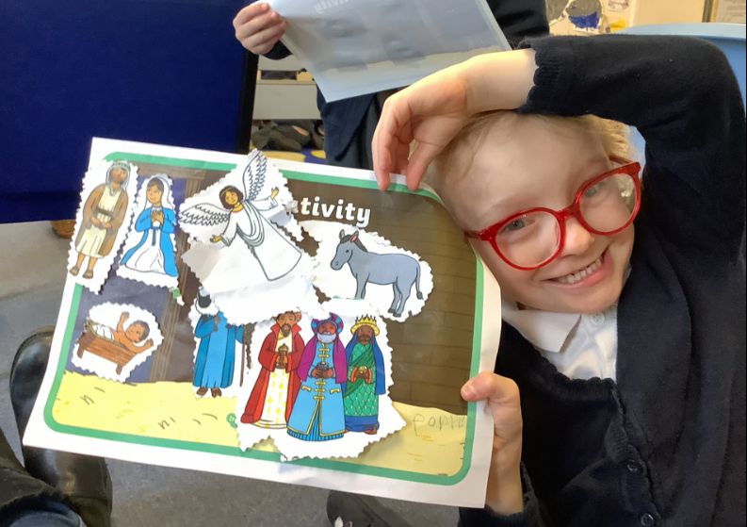
Butterfly Class Newsletter
12.12. 25
Wow!! What a week! We are so proud of how well the children walked to the church on Tuesday and Wednesday morning. Thank you to everyone who helped us walk there and back. We are also impressed with how incredibly well they did on Wednesday night, they sang beautifully and were wonderful angels. Thank you to everyone who attended. We’ve got a few busy weeks ahead of us so please use the calendar on the next page to keep up to date with what is happening each day.
Next weeks information:
15th December – Pantomime uniform.
17th December – Christmas Lunch and Christmas jumper day. Uniform worn under Christmas jumper.
19th December – Party day, party clothes to be worn. Carols on the playground at 3pm.
Pantomime:
Monday is the day of the pantomime. We will be leaving school at 9:15. Please pack your child’s bag light on this day. They will only need a change of clothes, named water bottle and a named nut free snack for the pantomime.

Slide 2


