Slide 1
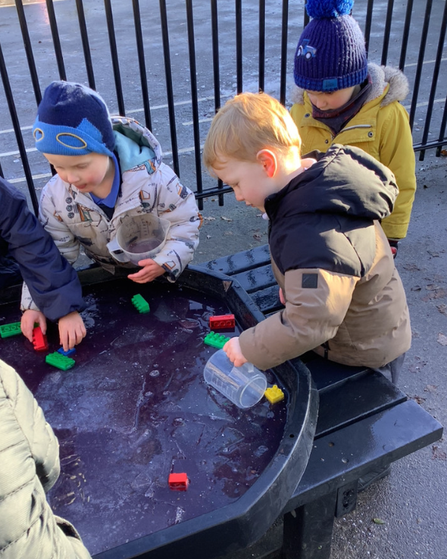
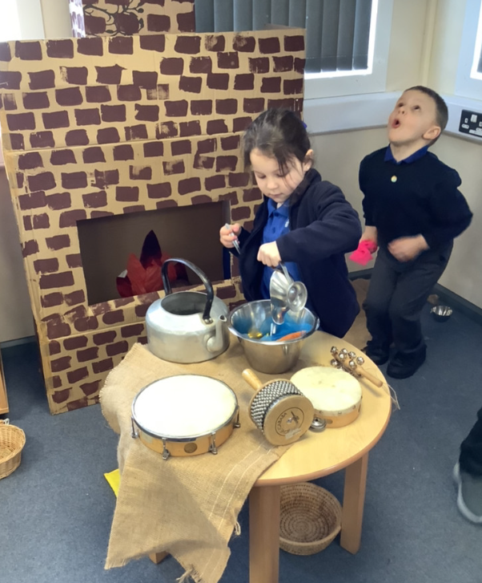
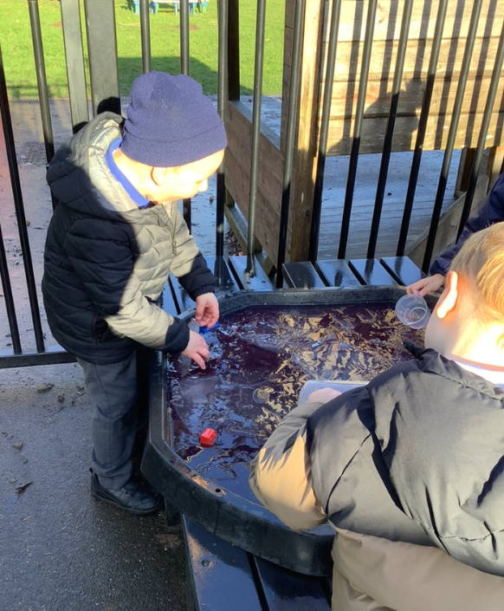
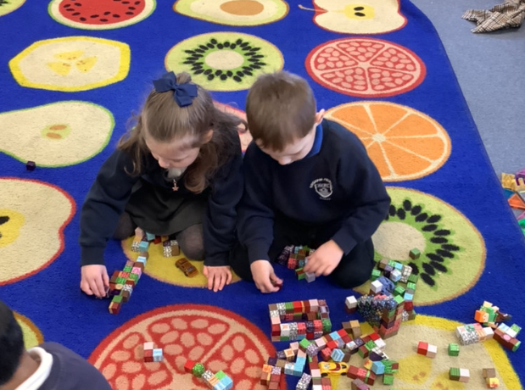
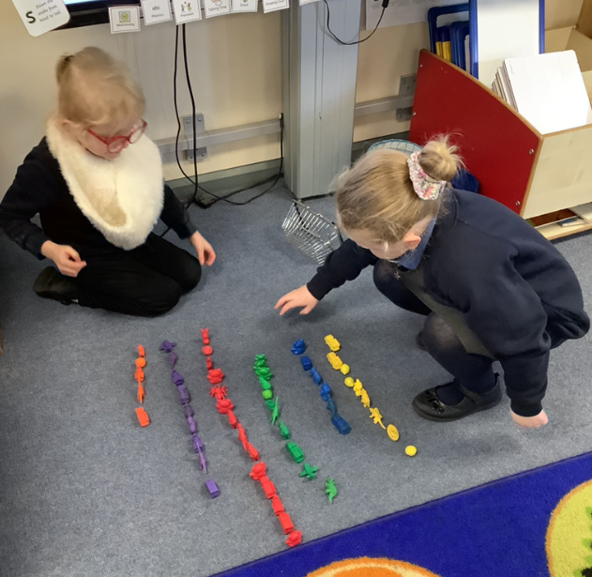
Butterfly Class Newsletter
09.06.26
I hope everyone had a wonderful Christmas and New Year. What a start to the new year! The children have coped incredibly well with coming back to school and especially with the fact that we’ve also had to deal with the cold and icy weather as well. They have really thrown themselves back into being at school and have been playing beautifully with each other. It’s been so lovely to see and just shows how far they’ve come in such a short space of time.
Reading and Sound Cards:
Please ensure children are reading their book at home. We aim for them to read at home 3 times a week. Please write this in their communication book and we will make sure they get a sticker for their effort. Children can also practise their sound cards as well and this still counts as reading.
No Nuts:
Please be extra vigilant with snacks that children bring into school. For morning snack we ask children either have fruit or vegetables. Thank you for your cooperation.

