Slide 1
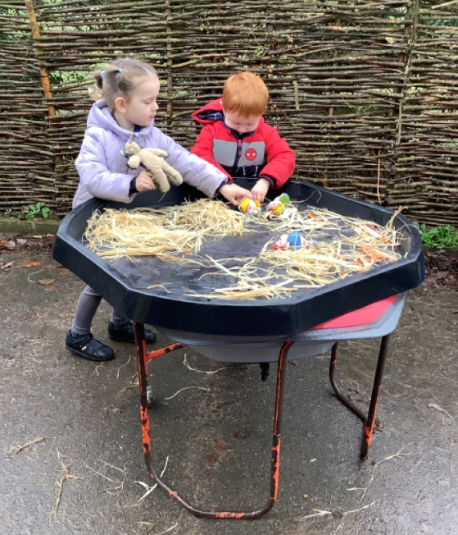
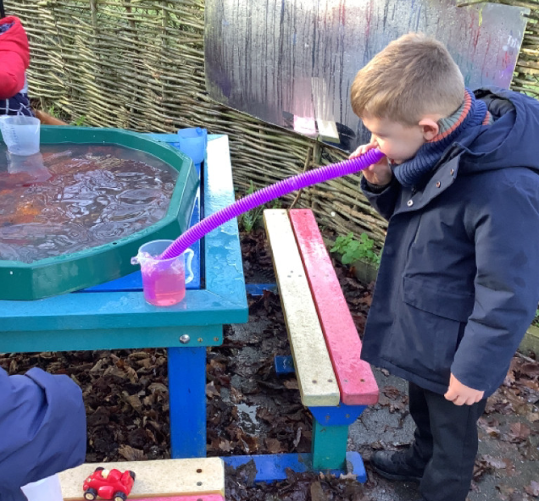
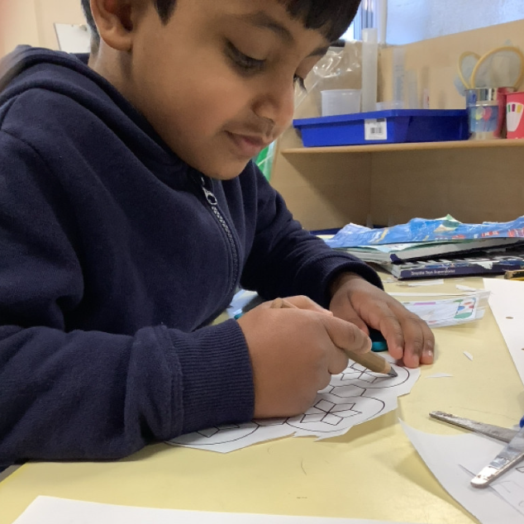
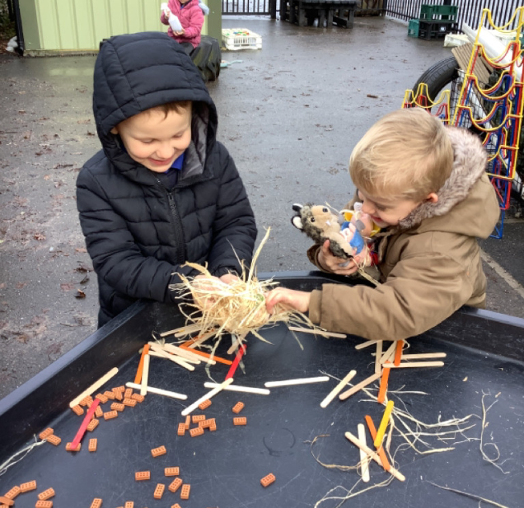
Butterfly Class Newsletter
16.01.26
This week the children have been getting busy outdoors. We have been using the story of The Three Little Pigs this week. The children have enjoyed retelling the story outside. They have even been using some adventurous vocabulary to describe the houses such as flimsy and sturdy. They have also experimented with leaving water outside each night and seeing what happens. We had ice one day and not then not the next so we talked about why this had happened.
Reading and Sound Cards:
Please ensure children are reading their book at home. We aim for them to read at home 3 times a week. Please write this in their communication book and we will make sure they get a sticker for their effort. Children can also practise their sound cards as well and this still counts as reading.
Named P.E kits:
Please can you make sure that all bits of the P.E kit have your child’s name in. It makes it much easier to find the owner when they take things like their jackets off.

