Slide 1
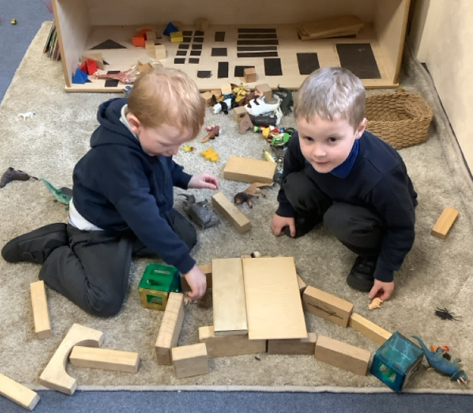
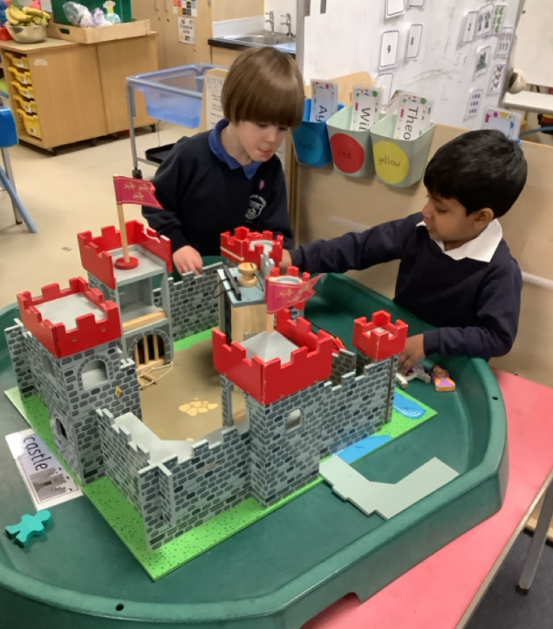
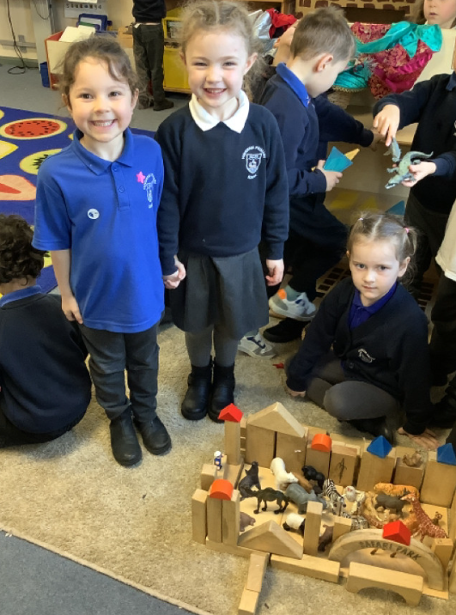
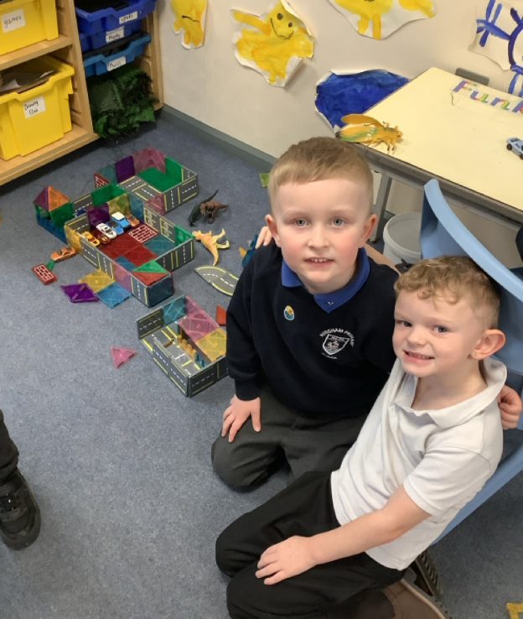
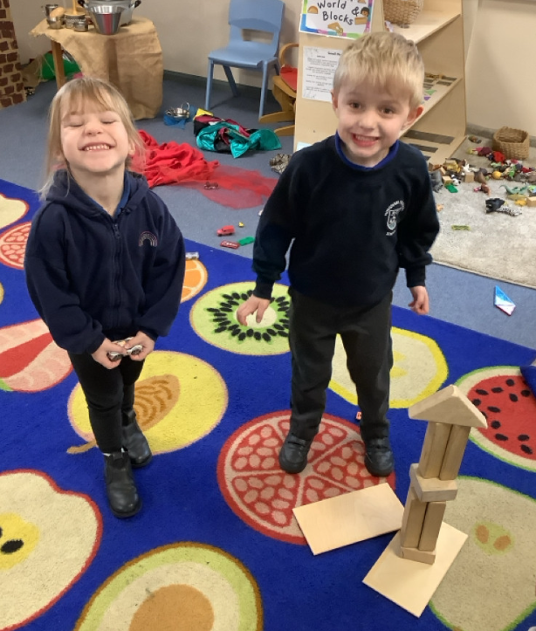
Butterfly Class Newsletter
23.01.26
This week the children have been all about building. They have really enjoyed our ‘Drawing Club’ animation, which this week has been Mr Benn. In this episode Mr Benn visited a zoo and helped the animals, from this the children have then been busy creating their own zoos. It has been wonderful to watch them working together so well. We have also been learning all about castles. From this the children worked together to create their own castles, drawing all the features that a castle would need.
Reading and Sound Cards:
Please ensure children are reading their book at home. We aim for them to read at home 3 times a week. Please write this in their communication book and we will make sure they get a sticker for their effort. Children can also practise their sound cards as well and this still counts as reading.
Mr Thorby:
From next week Mr Thorby is going to be on the door in the mornings, as he would like to begin building relationships with our families. Miss Gooch, Mrs Wood and Mrs Jackson will also be available if you would like to speak to one of us.

