Slide 1
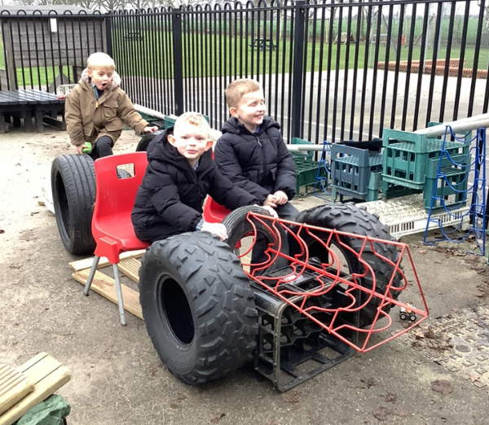
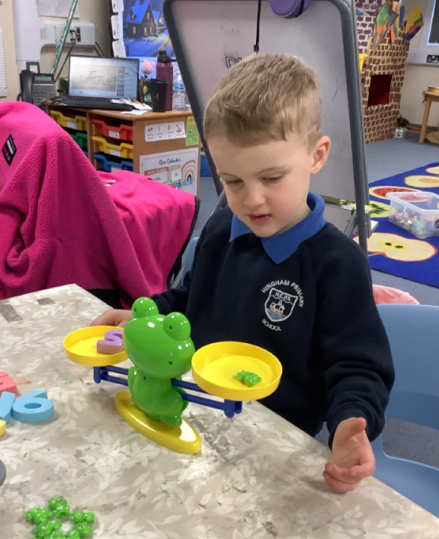
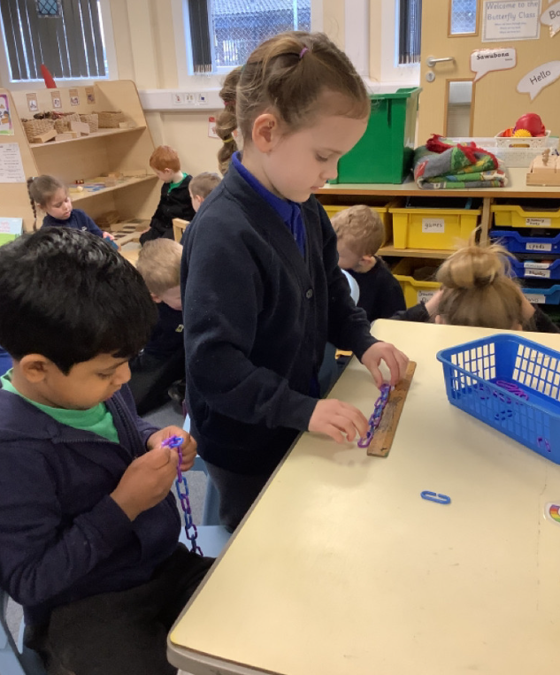
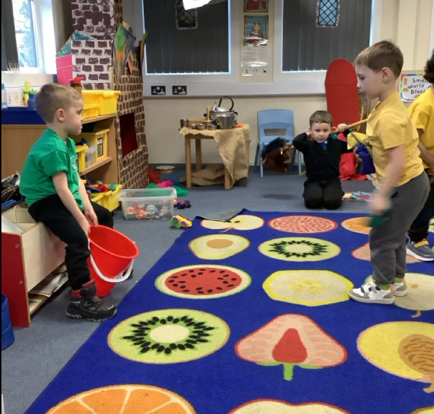
Butterfly Class Newsletter
30.01.26
This week we have continued our learning on castles. The children became knights at the beginning of the week when they had a go at jousting. They all gave it a good go and we think they would have been brave and bold knights. We have also been busy measuring things this week. The children have been learning about capacity and mass.
Reading and Sound Cards:
Please ensure children are reading their book at home. We aim for them to read at home 3 times a week. Please write this in their communication book and we will make sure they get a sticker for their effort. Children can also practise their sound cards as well and this still counts as reading.
Dinosaur Park Trip:
Next week a letter will come out about our trip to the Dinosaur Park, later this term. Please ensure consent and payment is made via school money.

