Slide 1
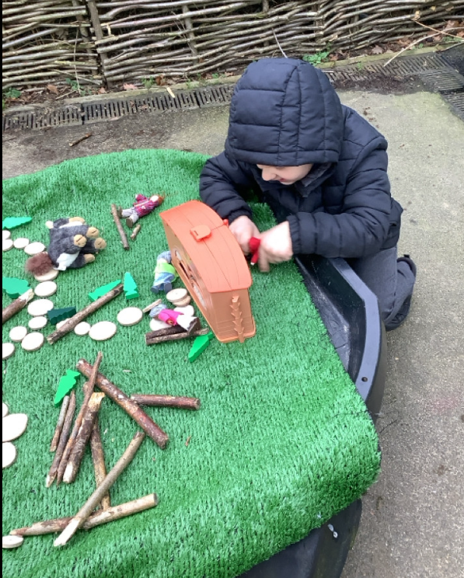
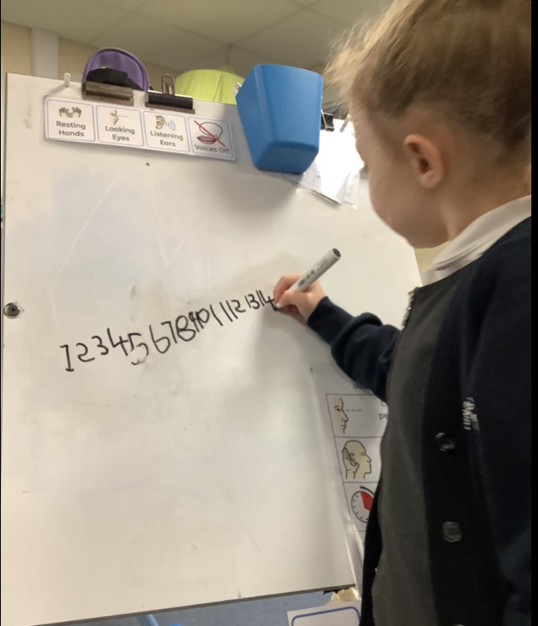
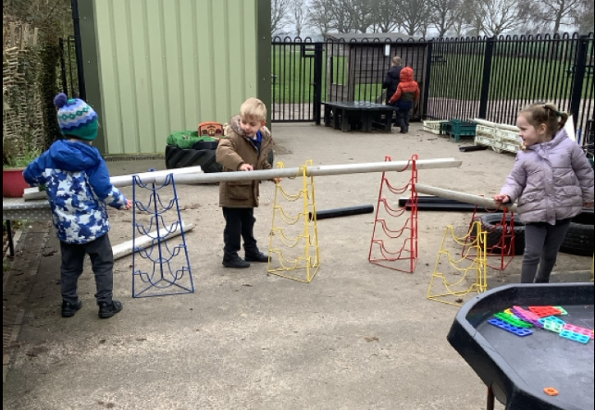
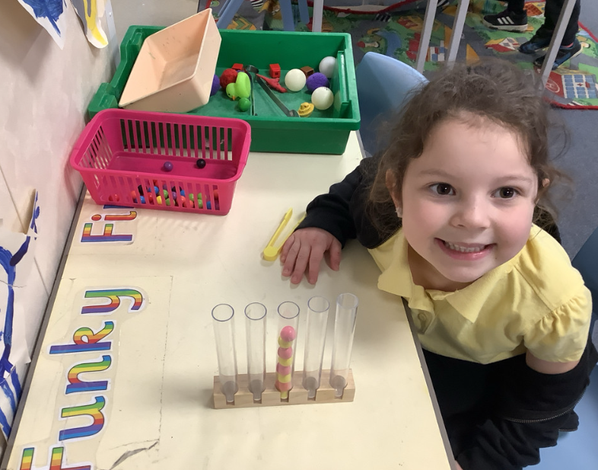
Butterfly Class Newsletter
06.02.26
This week has been all about story telling. We have been enjoying the story of Little Red Riding Hood. The children have been creating their own ideas based around the story. They have been writing lists of the things that Little Red Riding Hood might have put in her basket to take to Grandmas house. They even had a go at writing a different version of the story as a class.
Reading and Sound Cards:
Please ensure children are reading their book at home. We aim for them to read at home 3 times a week. Please write this in their communication book and we will make sure they get a sticker for their effort. Children can also practise their sound cards as well and this still counts as reading.
Mental Health Week:
Next week is mental health week. As part of this week will be looking at our emotions and feelings and playing games based around this topic.

