Slide 1
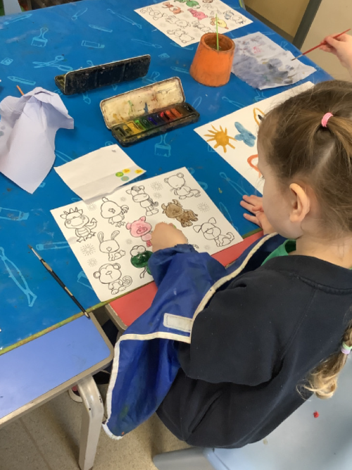
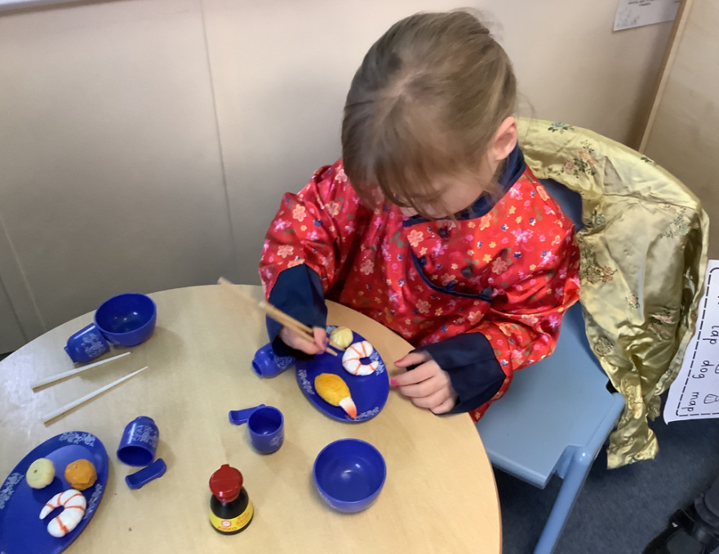
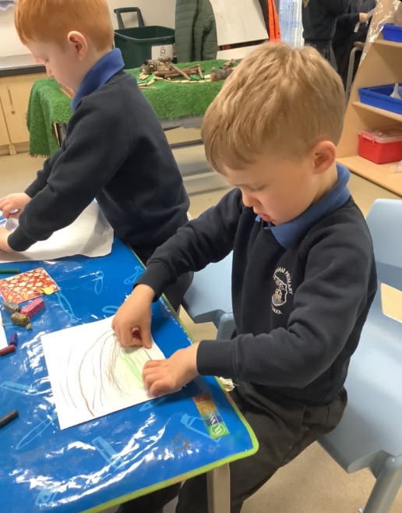
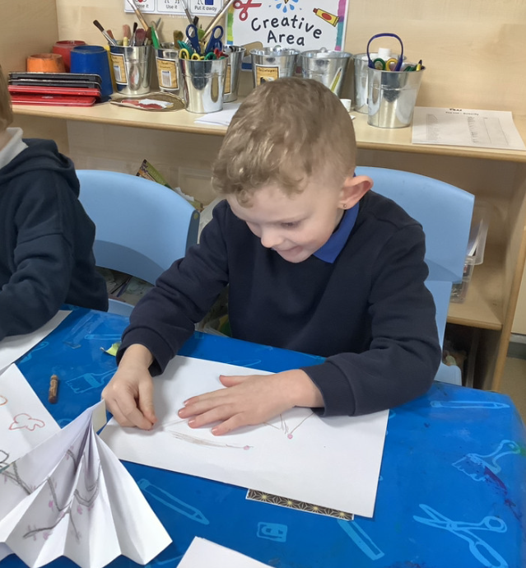
Butterfly Class Newsletter
12.02.26
This week the children have been learning about Chinese New Year. They have enjoyed learning about how people celebrate Chinese New Year and liked learning about the different zodiac animals. The children were very keen to learn about the year they were born and which zodiac animal this made them. The children were also very brave and stood up in front of Kingfisher class and told them a fact that they have learnt about castles. We are so proud of how well they did.
Reading and Sound Cards:
Over the half term please continue to read and share stories with your child. We will look at the communication books when we return and give out stickers as needed. They can also practice their sound cards and use these to make words to read. This counts as reading as well so please record it in the communication books.
Eat a Rainbow Sponsorship:
The Friends of Hingham Primary School have sent home a sponsorship form this week, encouraging children to eat all the colours of the rainbow. Please check the communication folders as all children went home with a sponsorship form.

