Slide 1
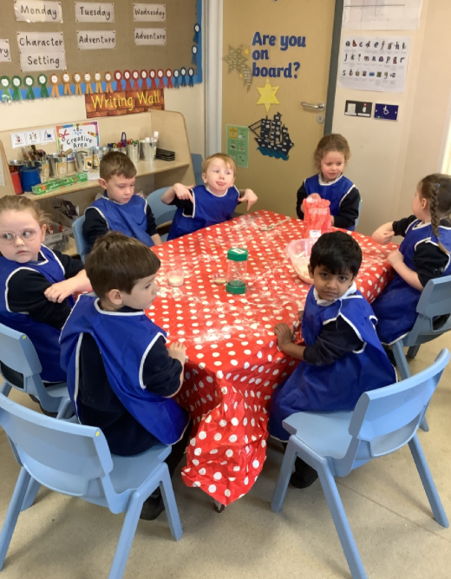
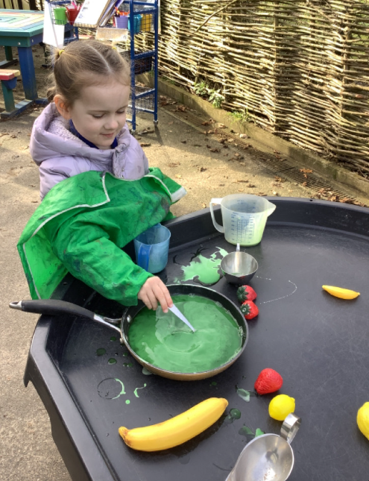
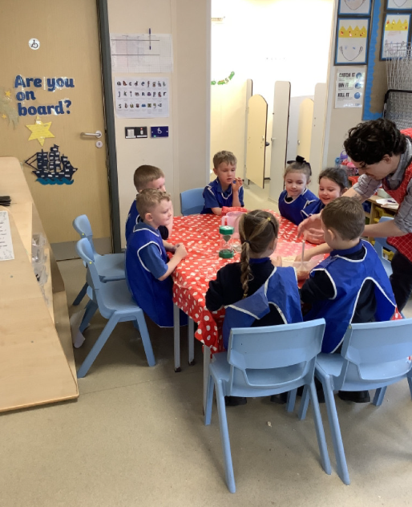
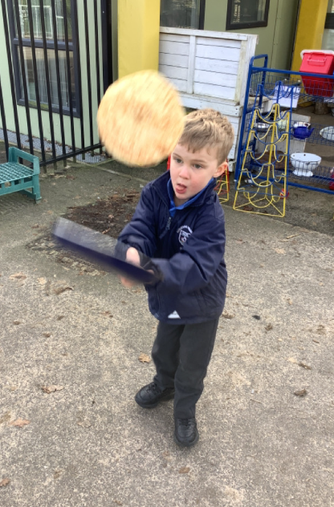
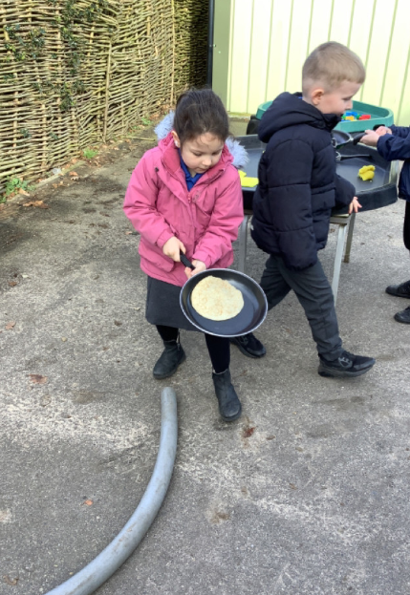
Butterfly Class Newsletter
27.02.26
It has finally felt like the spring term this week as we have had a little bit of sunshine. This week we have been learning all about pancake day and why and how people all over the world celebrate. The children had a go at flipping their own pancakes and mixing up their own mixtures outside. At the beginning of the week the children had a go at making bread rolls, we hoped they enjoyed eating them as much as we enjoyed making them.
World Book Day:
Thursday 5th March will be World Book Day. We encourage children to come dressed as a character from a book. We are also asking children to bring in one of their favourite stories and share with the class why they like it. Please can you write your child’s name in their book so we can keep track of who each book belongs to.
No P.E next week:
Next Thursday is World Book Day. We won’t do P.E on this day as the children will be dressed in their costumes. When P.E resumes the following Thursday can we please ask for trainers with no laces, the children really struggle with these especially when changing into their wellies at lunchtime.

