Slide 1
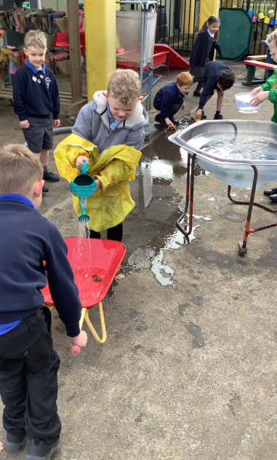
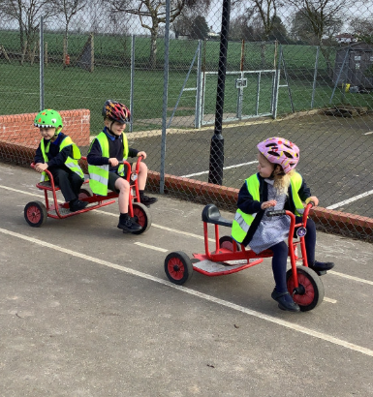
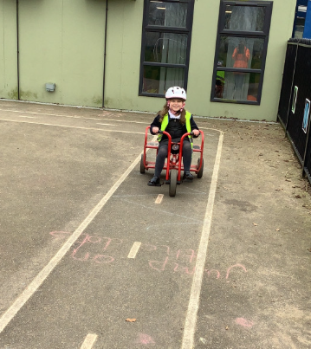
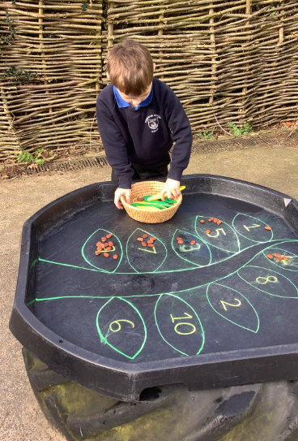
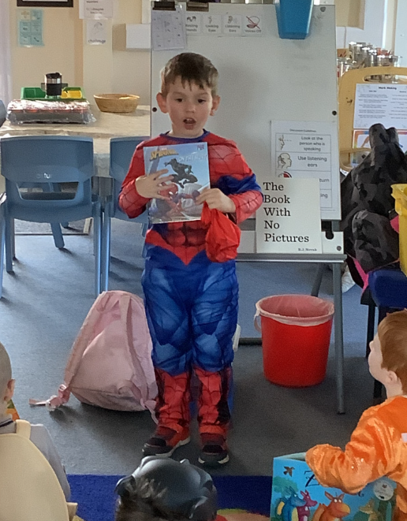
Butterfly Class Newsletter
06.03.26
We have had such a wonderful week. It was so lovely to have some proper sunshine back. We were able to get the water tray back out in the outside area and the children loved it! They were trying to fill up the wheelbarrow and then see if they could transport the water to the other end of the our playground. We have also been able to get the bikes back out and the children have loved being able to get pedalling again. Thursday was World Book Day, the children had so much fun and the highlight of the day was when Year 6 came over to read stories to us. It’s been a truly lovely week.
Helmets:
The bikes will now be accessible all day everyday (weather permitting) for those children that would like to ride them. Please ensure your child has a helmet in school otherwise they won’t be able to use the bikes.
Reading:
It was so wonderful to watch the children enjoying stories on Thursday. Children reading at home is so important to developing a love of reading . We encourage children to read at home at least 3 times a week. Please record any reading in their communication book.

