Slide 1
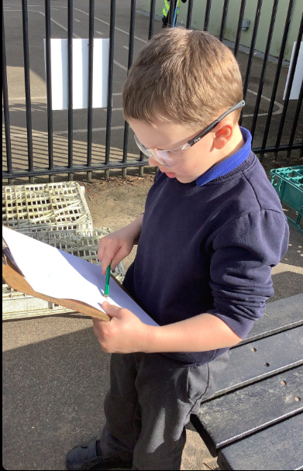
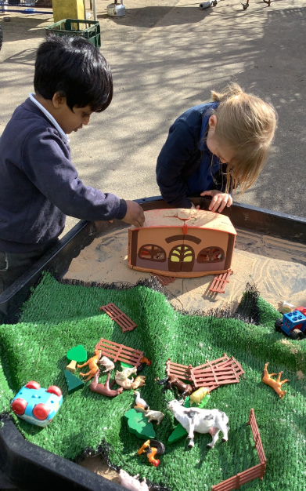
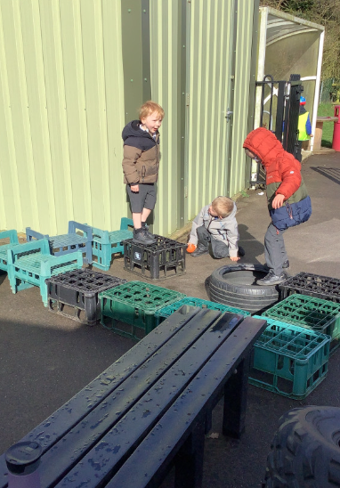
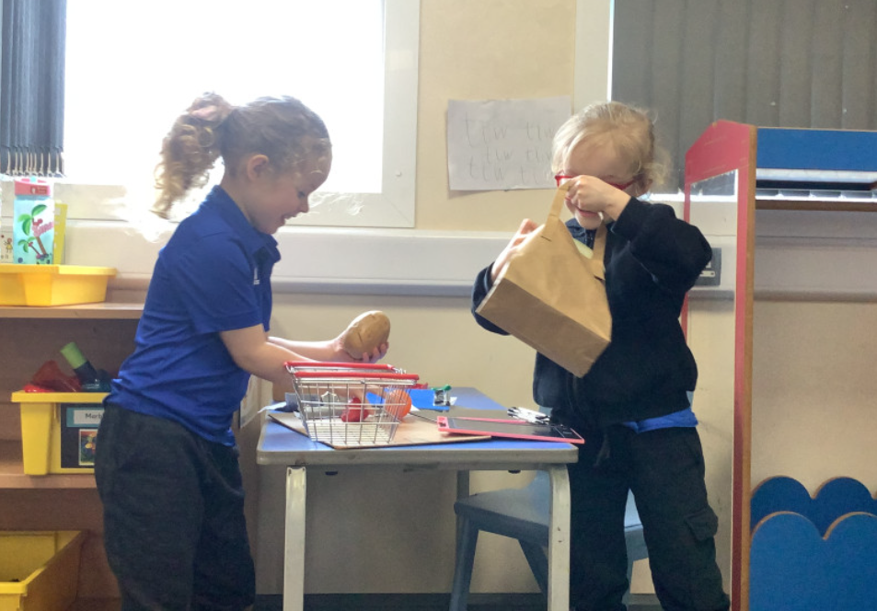
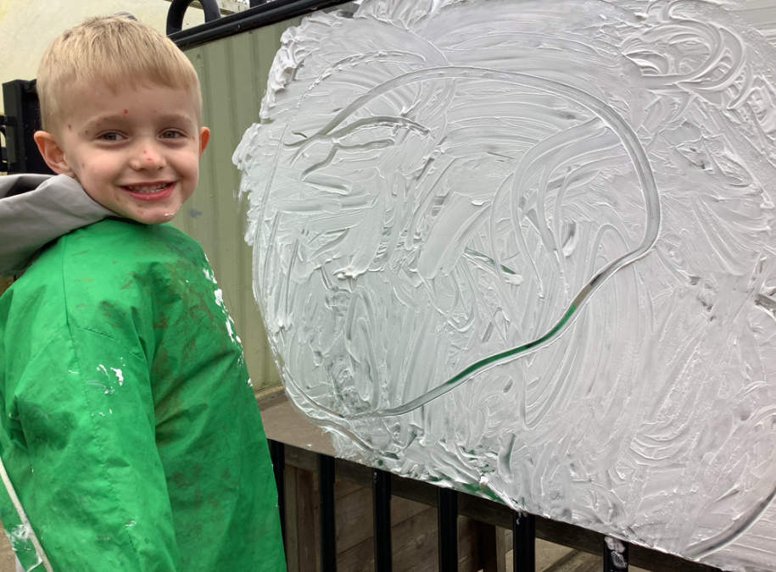
Butterfly Class Newsletter
13.03.26
It’s been another busy week in Butterfly class. This week the children have been getting very creative outside. They have continued to enjoy using the bikes and some children are getting really confident with balance and pedalling. We have been getting very creative outdoors this week. The children have been mark making in shaving foam, painting on the ground, building obstacle courses and making maps.
Helmets:
The bikes will now be accessible all day everyday (weather permitting) for those children that would like to ride them. Please ensure your child has a helmet in school otherwise they won’t be able to use the bikes.
Reading:
It was so wonderful to watch the children enjoying stories on Thursday. Children reading at home is so important to developing a love of reading . We encourage children to read at home at least 3 times a week. Please record any reading in their communication book.

