Slide 1
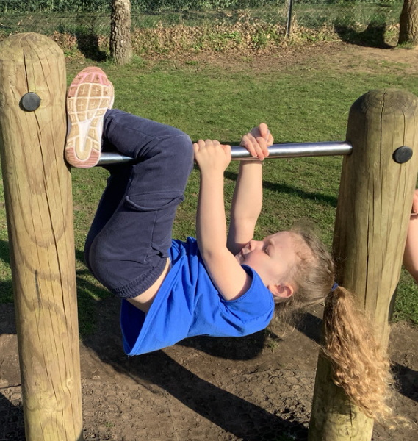
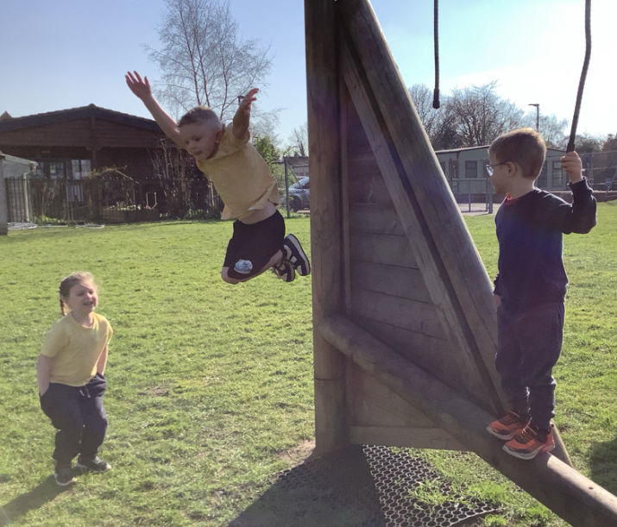
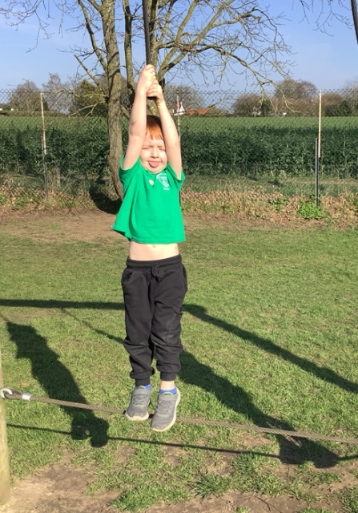
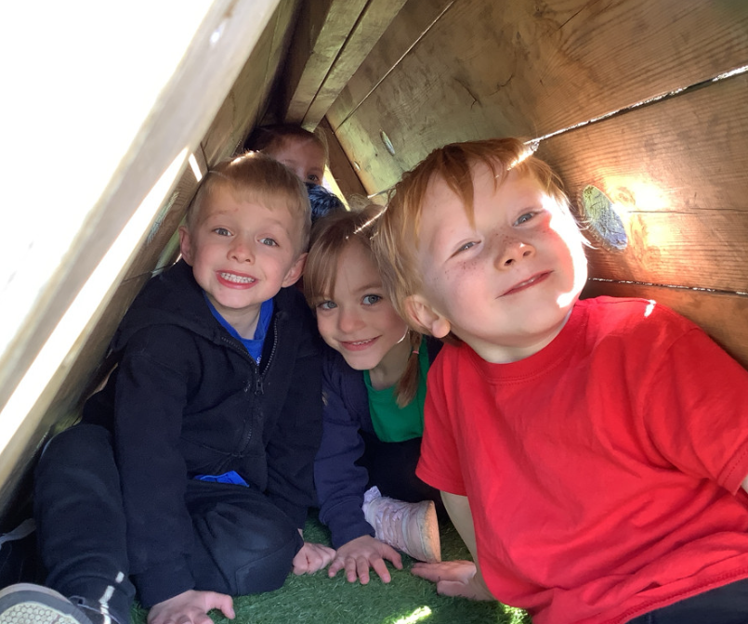
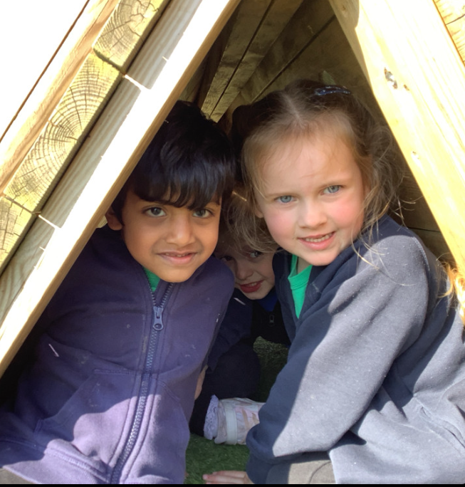
Butterfly Class Newsletter
19.03.26
Wow! I cannot believe we are one week closer to the end of another term. I wanted to thank you all for such wonderful parents evenings this week, it is so lovely to have the time to talk about the children and look at how far they have come since joining us in September. We are so proud of them all and would like to thank you for all your hard work and support. It’s been so nice to be able to get outside this week. The children did P.E on the field for the first time this year and got to have a go on the trim trail, which they loved. Next week is set to be another busy one starting off with our trip to the Dinosaur Park on Monday.
Dinosaur Park:
On Monday we will be heading on our second trip of the year. Children will be carrying their own bags around for the day so please pack light. Lunch, change of clothes, water bottle and snack are the only things needed on this day.
Reading:
It was so wonderful to watch the children enjoying stories on Thursday. Children reading at home is so important to developing a love of reading . We encourage children to read at home at least 3 times a week. Please record any reading in their communication book.

