Slide 1
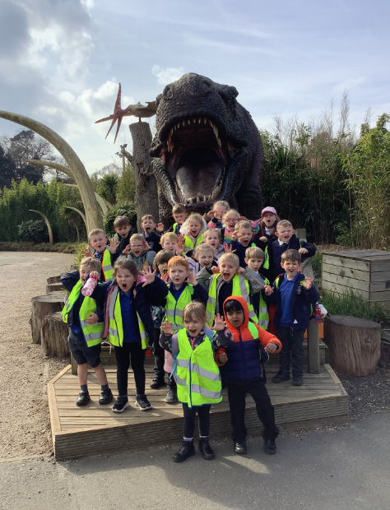
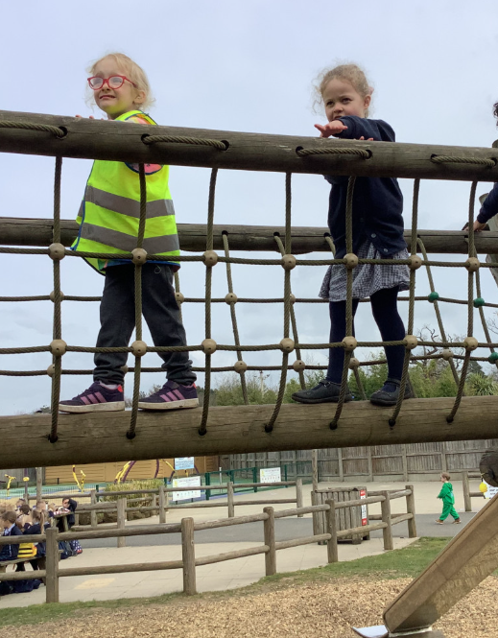
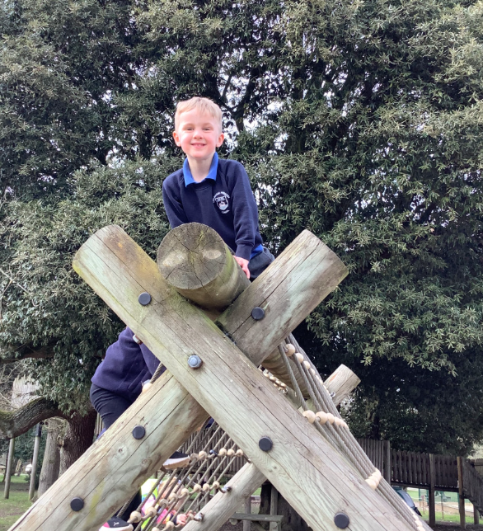
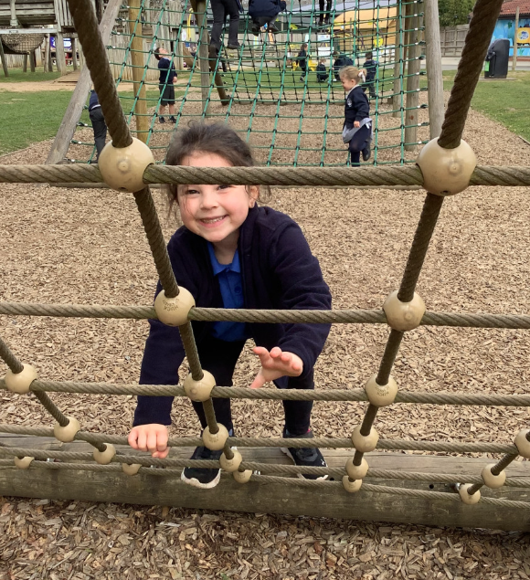
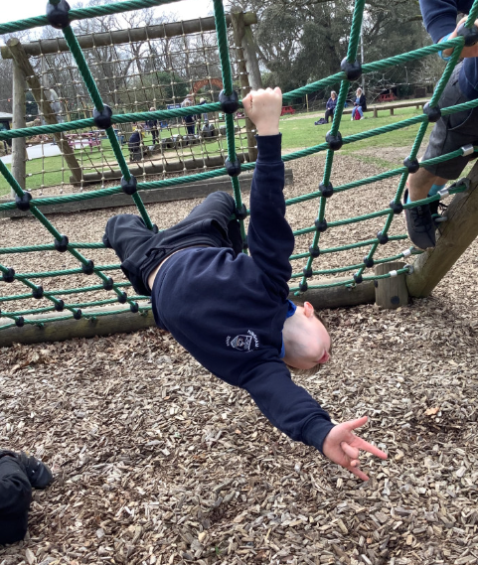
Butterfly Class Newsletter
27.03.26
We’ve reached the end of another term. We cannot believe how fast the time is going. It’s been another busy term and the children have learnt so much. It’s wonderful to watch them make so much progress in their own ways. Have a wonderful Easter and we will see you bright and early on 14th April.
Mr Thorby:
Mr Thorby will be spending next half term at a different school. He will be back after May half term. He wanted to pass on his thanks and is looking forward to seeing the children again soon.
Class photos:
On the Thursday we return to school it will be class picture day . This will mean the children will need to come to school in uniform on this day and not in their P.E kit. I will also send a reminder nearer the time.

