Slide 1
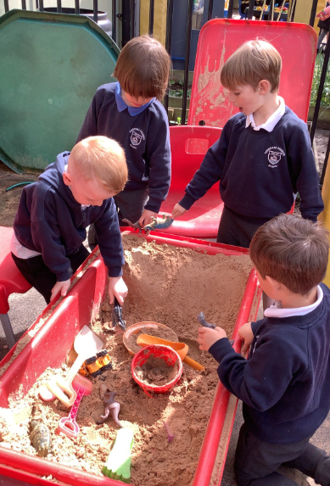
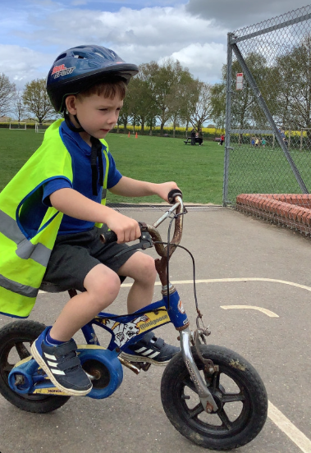
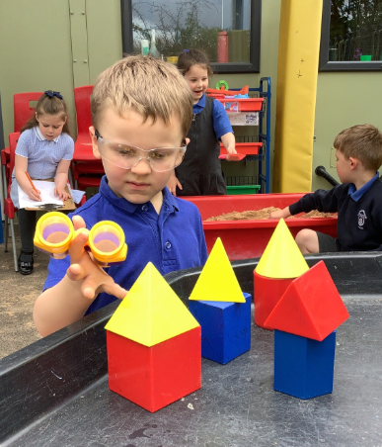
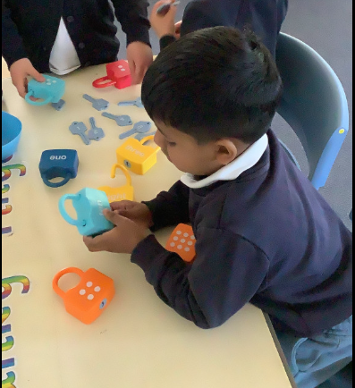
Butterfly Class Newsletter
17.04.26
A warm welcome back to the summer term. All of the children settled straight back in and were enjoying telling us about their Easter holidays. It has felt slightly more like we are getting towards warmer days as we have spent lots of time outdoors this week. The children have got stuck into our new dinosaur topic and have been talking about some of the things we learnt whilst at the Dinosaur Park.
Sun Cream:
As the weather gets nicer please ensure your child comes to school with sun cream applied and they can bring more with them to apply independently at lunchtime. Please check the sun cream bottles to ensure there are no traces of nuts.
P.E:
We will be back to P.E as normal next Thursday so please send your child to school in their P.E kit. Colour team t-shirt, joggers or shorts, trainers and a jumper as needed. Please make sure all items are labelled.

