Slide 1
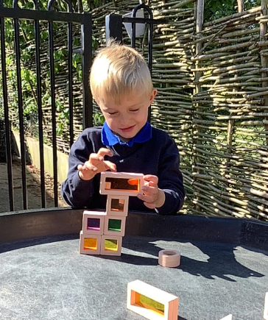
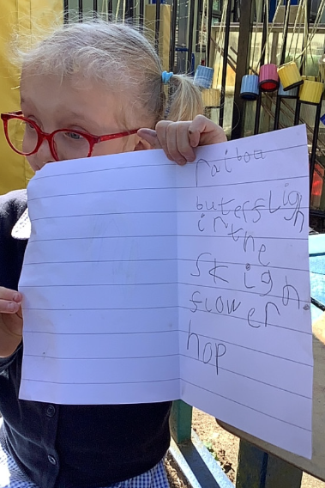
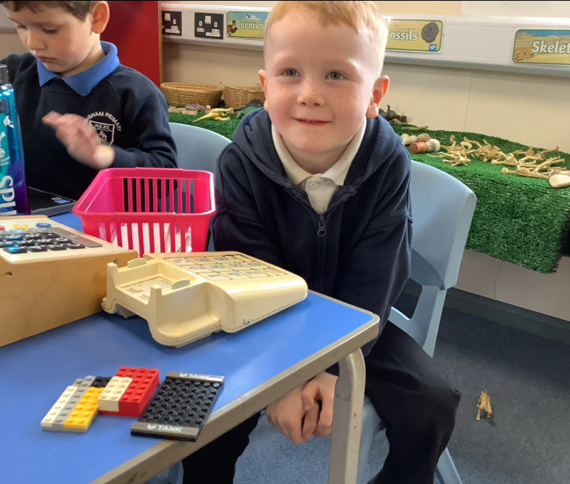
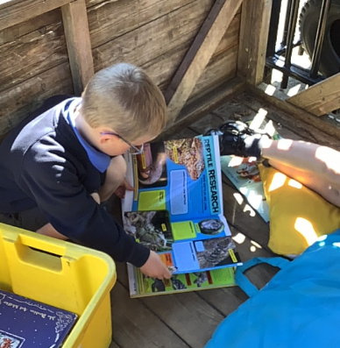
Butterfly Class Newsletter
24.04.26
We have been getting stuck in to all things dinosaur this week. The children have been searching for dinosaur bones in the sand, as well as learning about why certain dinosaurs had different features. The children have really enjoyed being able to be out in the sunshine as well this week. On Thursday they created their own stage outside and had a their very own dance party. It’s been such a lovely week. We are really enjoying the summer term.
Spare Clothes:
We are running low on spare pairs of pants and knickers. If your child has come home in a school pair could these be return. Please also ensure they have a spare pair of clothes in their bag.
Poetry performance:
We have been working hard to learn some dinosaur themed poems. We would like to invite you to our poetry performance on Thursday 21st May at 2:55pm in the school hall.

