Slide 1
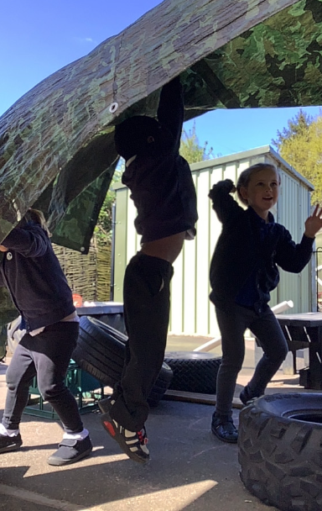
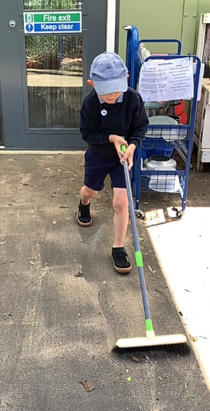
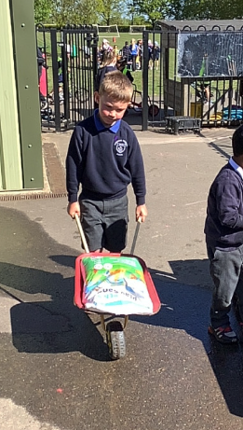
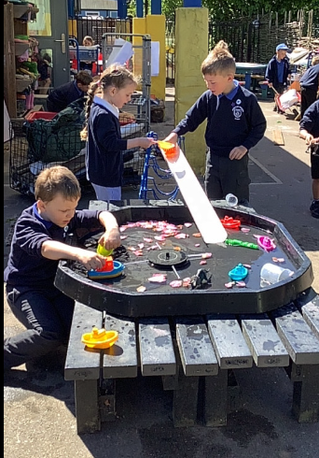
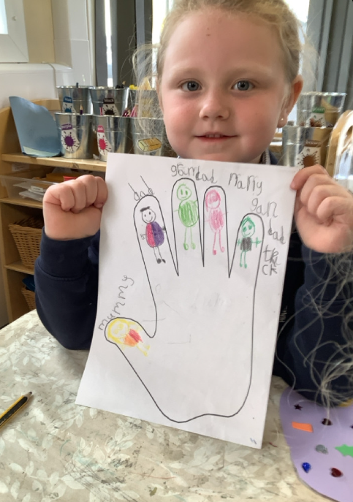
Butterfly Class Newsletter
01.05.26
We have spent lots of time outside this week. The children have been enjoying making dens, they really enjoyed the windy weather and how this made their den float into the air. There was lots of hysterical laughter. We’ve also had lots of helpful children moving our outdoor area around and having a bit of a tidy up.
Spare Clothes:
We are running low on spare pairs of pants and knickers. If your child has come home in a school pair could these be return. Please also ensure they have a spare pair of clothes in their bag.
Poetry performance:
We have been working hard to learn some dinosaur themed poems. We would like to invite you to our poetry performance on Thursday 21st May at 2:55pm in the school hall.

