Slide 1
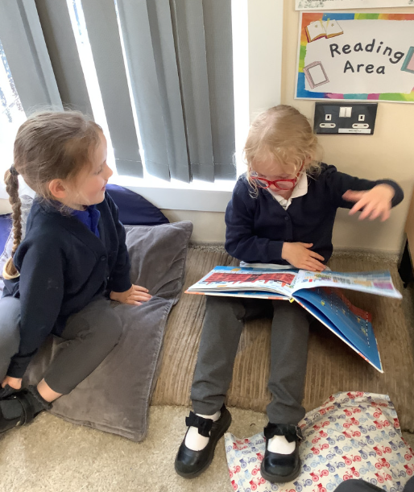
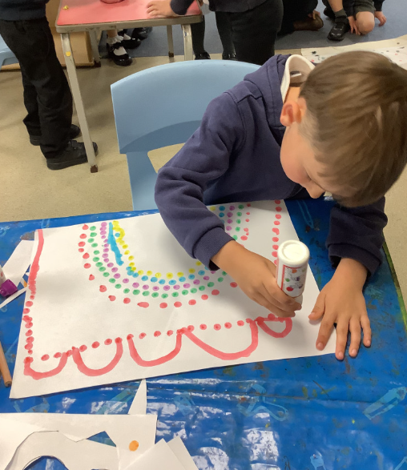
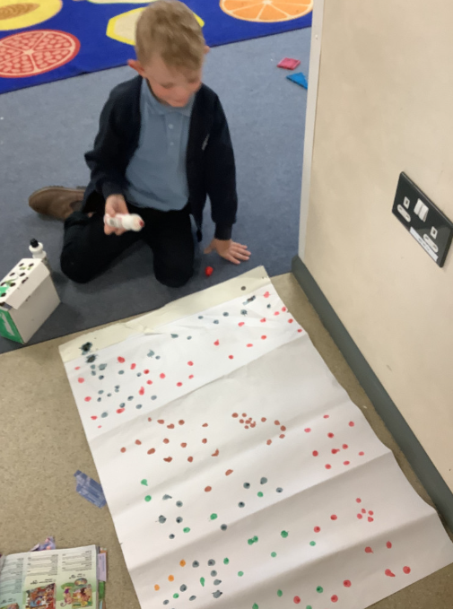
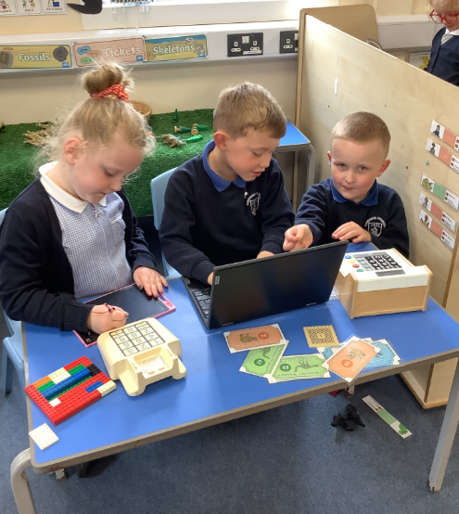
Butterfly Class Newsletter
08.05.26
It’s been another busy week in Butterfly Class. The children have been enjoying all things creative this week. They have been making dinosaur pictures with bingo dabbers. This then led them onto creating their own masterpieces using the bingo dabbers. We’ve had rainbows, portraits and pieces of modern art. You name it, they’ve probably drawn it!
Spare Clothes:
We are running low on spare pairs of pants and knickers. If your child has come home in a school pair could these be return. Please also ensure they have a spare pair of clothes in their bag.
Poetry performance:
We have been working hard to learn some dinosaur themed poems. We would like to invite you to our poetry performance on Thursday 21st May at 2:55pm in the school hall. Please come to the side door at the front of the building, near Fox Class.

