Slide 1
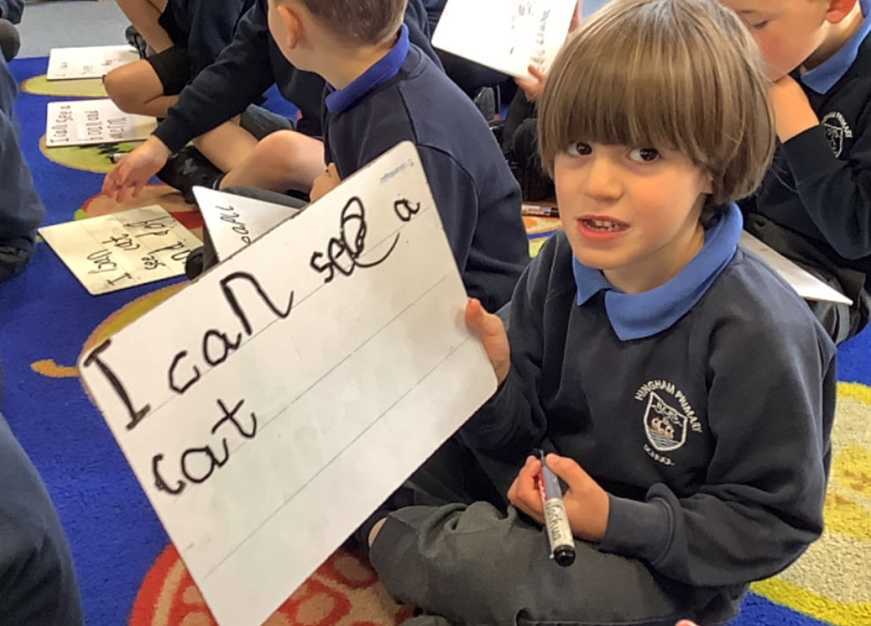
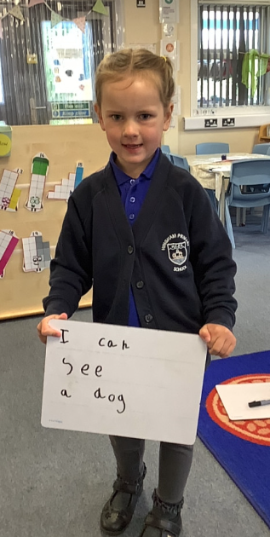
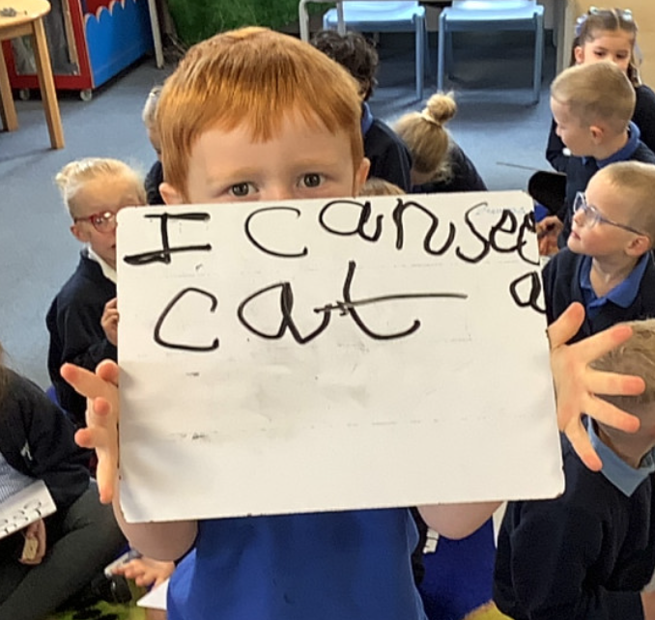
Butterfly Class Newsletter
15.05.26
Independence:
As we begin to prepare the children for moving into Owl Class we are trying to encourage them to carry their own bags into school and begin to sort out their own belongings, by putting their reading folder in the box independently. Please encourage your child to do this when they come in, in the morning.
Reading books:
Next week, we will be sending the children home with new reading books ready for half term. With various things happening next week your child may not read this book at school as many times as they normally would. Please continue to read with them at home next week and over the holidays. We will continue to give stickers out for any reading completed at home.
Safe Strangers:
As part of our personal, social and emotional development the children have been learning about safe strangers. These are people such as police, doctors, nurses etc. Please feel free to discuss this further with your child at home.
Poetry performance:
We have been working hard to learn some dinosaur themed poems. We would like to invite you to our poetry performance on Thursday 21st May at 2:55pm in the school hall. Please come to the side door at the front of the building, near Fox Class.

