Slide 1
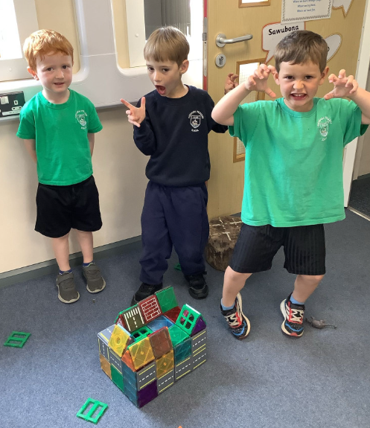
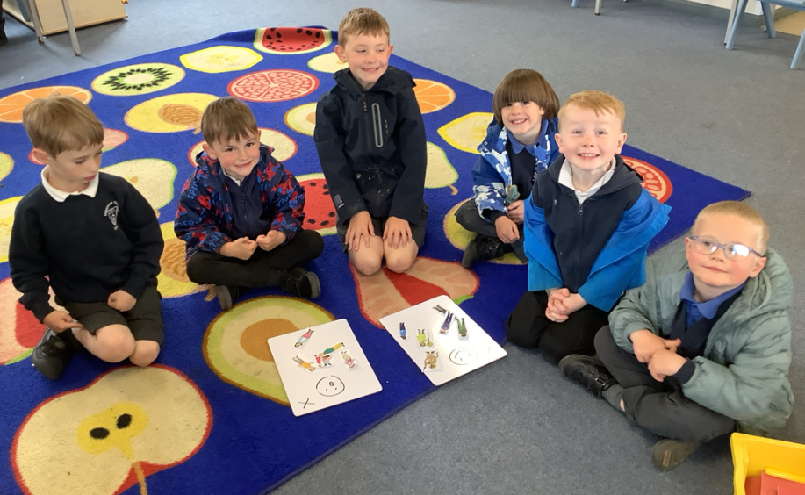
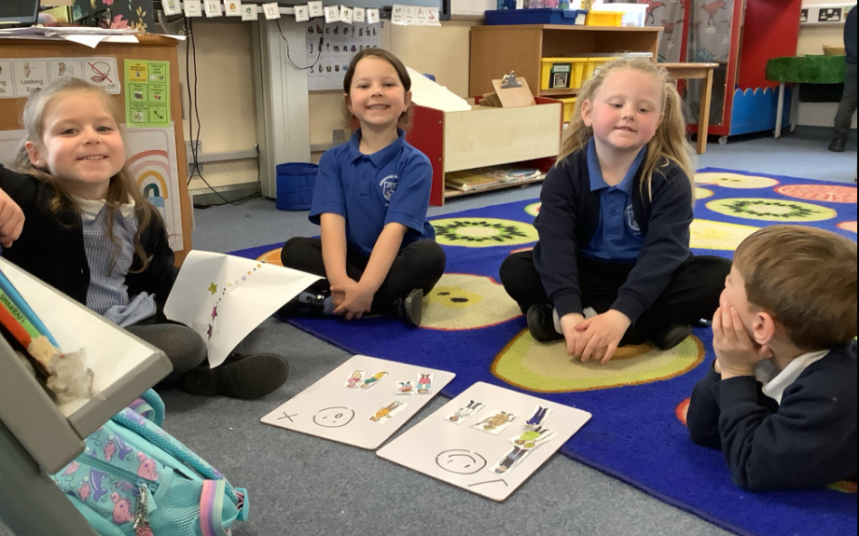
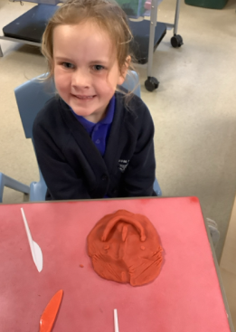
Butterfly Class Newsletter
22.05.26
I cannot believe that we have come to the end of another half term. The children have continued to amaze us and we are having such a wonderful time in Butterfly Class. I wanted to say a huge thank you to everyone that attend the poetry performance. The children had worked so hard to learn the poems and it was a great experience for them to perform in front of an audience. I hope you all enjoy an d restful and hopefully sunny half term. See you at 8:45 am on Monday 1st June, when we will also be welcoming back Mr Thorby.
Sports Day: 3rd June
Please make sure your child comes to school in their P.E kit and colour team t-shirt on this day. As the weather is unpredictable please make sure your child has a water bottle, sun hat, sun cream and jumper should the weather be colder. Parents/carers are welcome to attend from 1:15pm.
Reading and Flashcards:
Please record any reading or flashcard practise in the communication books over the half term holiday.

