Slide 1
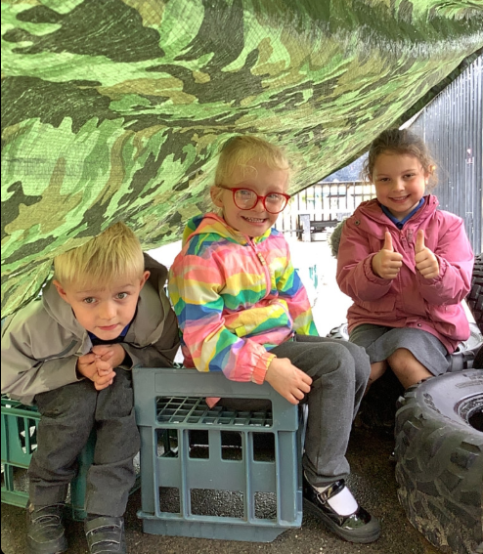
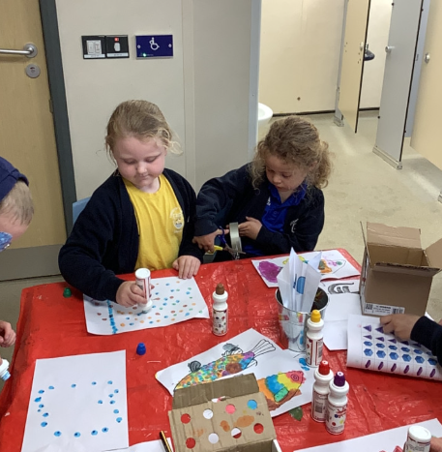
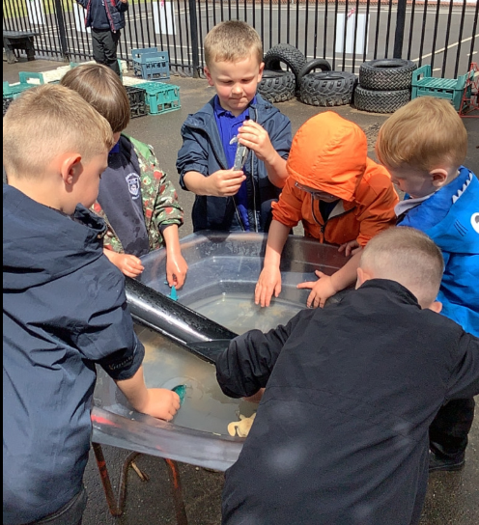
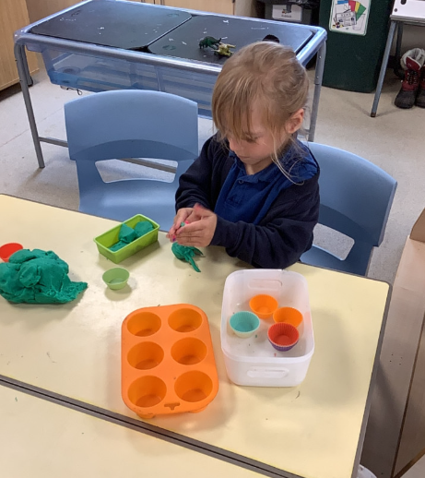
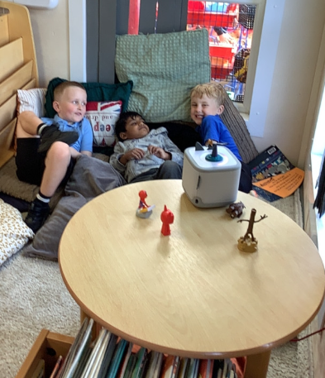
Butterfly Class Newsletter
05.06.26
Well, it’s been a busy first week back. The children have got back into the routines of school quickly. They have been playing beautifully with each and have coped really well with the ever changing weather. Although, Sports Day didn’t happen we did still go outside and practise our races and the children did incredibly well. We have also been lucky enough that the Friends have bought us a Tonie Box for our reading corner the children have loved listening to the stories. All in all a fabulous first week back.
Spare Clothes:
Please make sure your child has named spare clothes with them at all times. They may not need them for accidents but with the rainy weather we have had to lend out lots of spare clothes this week due to children either getting wet in the rain or wet from playing in the water tray.
Walkers:
Next Friday 12th June, we will be walking to Lincoln Hall to watch the Year 5 and 6 in their dress rehearsal. If you would be able to help us walk that would be greatly appreciated. Just let one of us know on the door.

