Slide 1
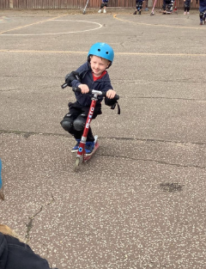
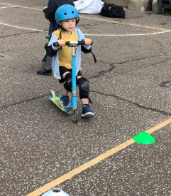
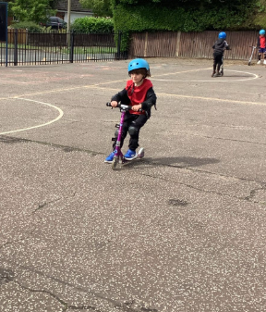
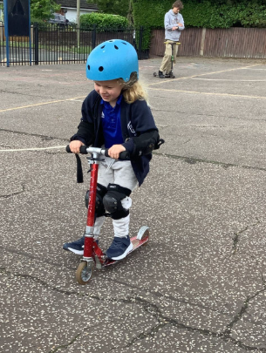
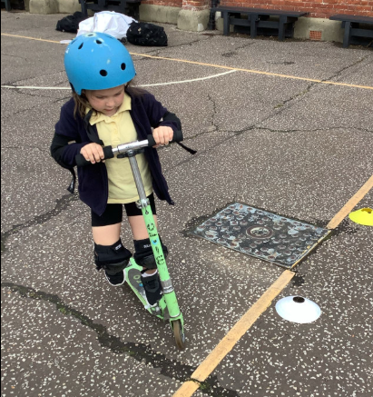
Butterfly Class Newsletter
12.06.26
We’ve had another fun filled week in Butterfly Class. The children had so much fun on Tuesday when they had a go a using two wheeled scooters. We were all very impressed with their determination and resilience. By the end of the session some of the children were beginning to do bunny hops on the scooters. This week we have also been learning how to keep safe at the seaside. We have been learning what each of the different flags means when you visit the beach. The children even had a go at making their own flags.
Spare Clothes:
Please make sure your child has named spare clothes with them at all times. They may not need them for accidents but with the rainy weather we have had to lend out lots of spare clothes this week due to children either getting wet in the rain or wet from playing in the water tray.
Beach Trip:
On Thursday 16th July we will be heading to Gorlestone beach with Owl Class. More details will be sent out in the next few weeks so keep your eyes peeled for this as consent will need to be given on School Money.

