Slide 1
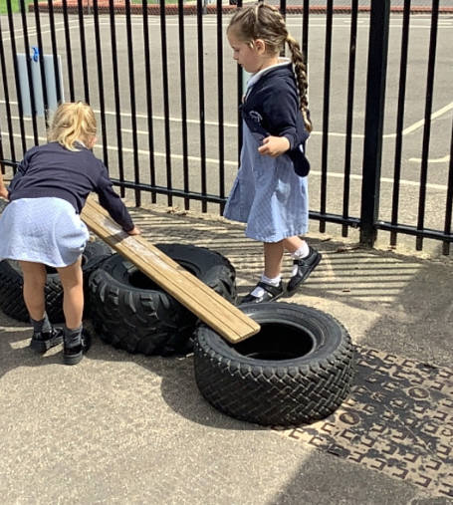
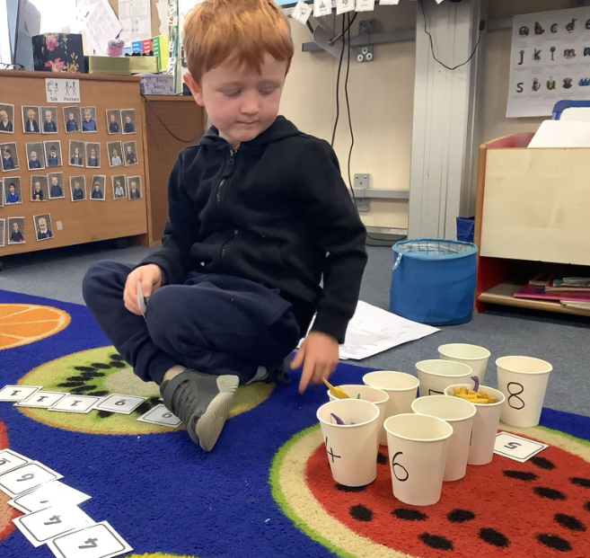
Butterfly Class Newsletter
19.06.26
This week we have been learning about seaside in the past. The children have really enjoyed looking at what the seaside was like in the past, we looked at what people wore at the seaside and how they used bathing machines to change into their swimwear. This led to the children making a pier outside. We also watched our own Punch and Judy show. The children then made their own Punch and Judy puppets. Lots of fun and laughter had all round this week.
Dates for the diary:
25th June – Transition morning (moving up to Owl Class), children come into Butterfly Class as normal.
2nd July – Sports Day (fingers crossed)
3rd July – Hingfest (after school)
8th July – Transition afternoon (move up to Owl Class), collect as normal at the end of the day.
9th July – Transition morning (move up to Owl Class), children come into Butterfly Class as normal.
16th July – Beach Trip
17th July – Break up for Summer Holidays
Beach Trip:
Please make sure that consent is given on School Money ready for our trip to the beach. The option is lunch this day is a pasta pot so please bare in mine we cannot take forks with us so children would need to either eat this with their fingers or bring their own fork to use.

