Slide 1
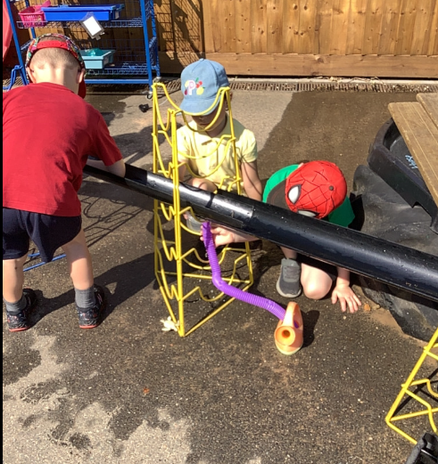
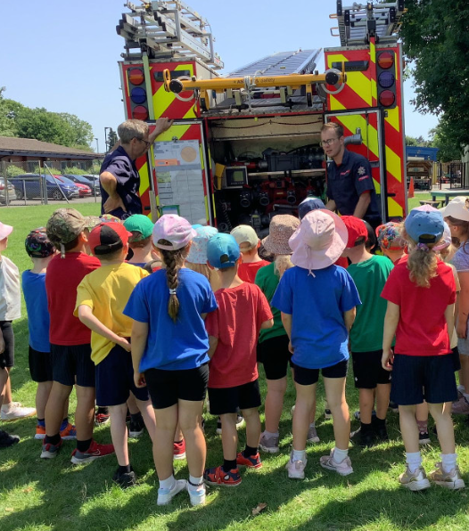
Butterfly Class Newsletter
26.06.26
Well, it’s been a week!! We have been trying to keep the children as cool as possible in this hot weather. We have spent lots of time inside our lovely air conditioned classroom and many, many drinks breaks. The children have coped incredibly well with the heat and the changes that this has brought to our normal routine. The children had a wonderful visit to Owl Class on Thursday morning and told us all about it when they came back to see us. Although, we’re glad they has a lovely time we’re not sure we are ready to let them go just yet. We were also lucky enough to get to see a fire engine on the field this week. The children loved listening to the firefighters talk about the fire engine.
Dates for the diary:
2nd July – Sports Day (fingers crossed)
3rd July – Hingfest (after school)
8th July – Transition afternoon (move up to Owl Class), collect as normal at the end of the day.
9th July – Transition morning (move up to Owl Class), children come into Butterfly Class as normal.
16th July – Beach Trip
17th July – Break up for Summer Holidays

