Slide 1
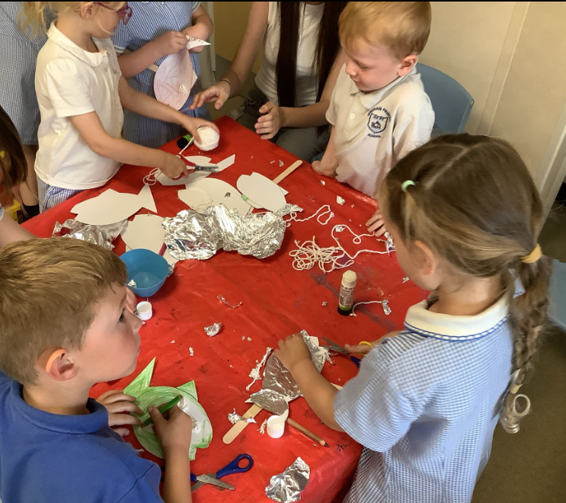
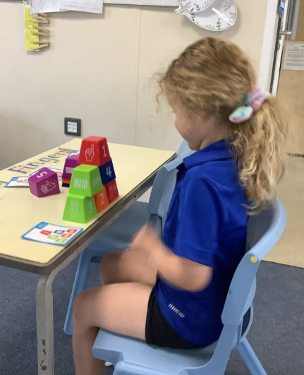
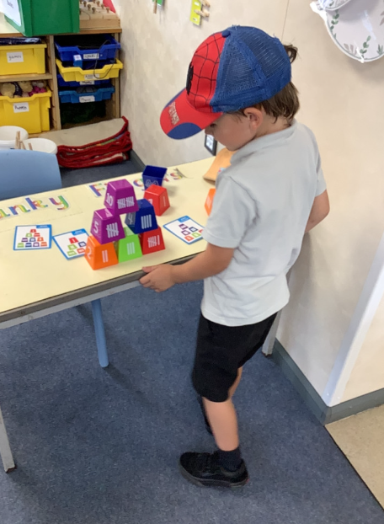
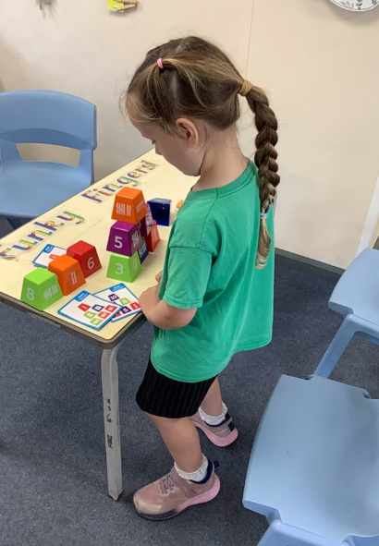
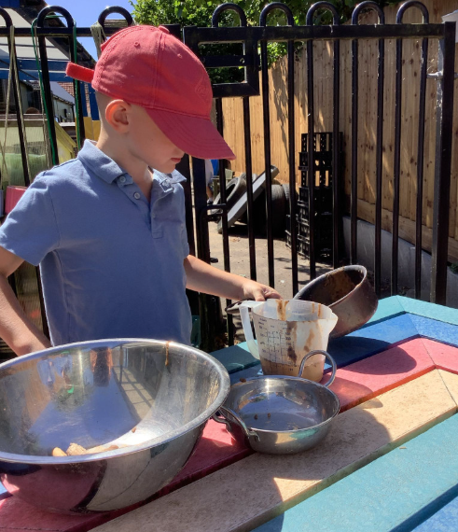
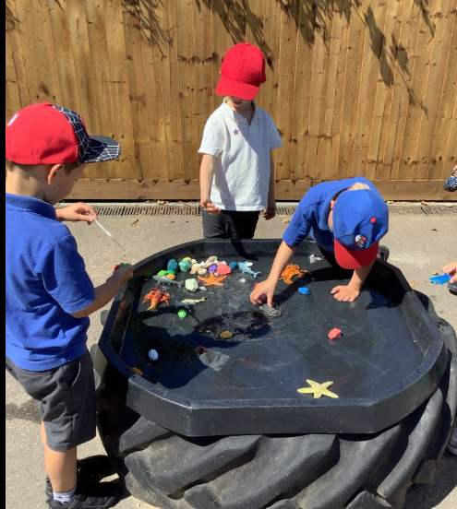
Butterfly Class Newsletter
03.07.26
First of all can we say a big thank you for everyone who came to support the children on Sports Day. We appreciate how difficult it is to take time off work, so after having to rearrange the date we are truly grateful for you being there to support the children in their first sports day and we are so proud of how they did. Well done Butterfly Class! This week the children have also been wonderful in helping support the children from playgroup who have come across for a visit. They have been so kind and caring and showing the children where things are in Butterfly Class and talking to them about their favourite things to do. Absolute superstars!
Dates for the diary:
8th July – Transition afternoon (move up to Owl Class), collect as normal at the end of the day.
9th July – Transition morning (move up to Owl Class), children come into Butterfly Class as normal.
16th July – Beach Trip
17th July – Break up for Summer Holidays

