Slide 1
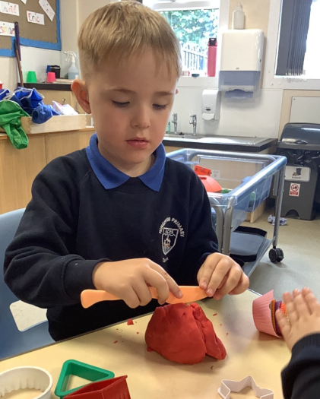
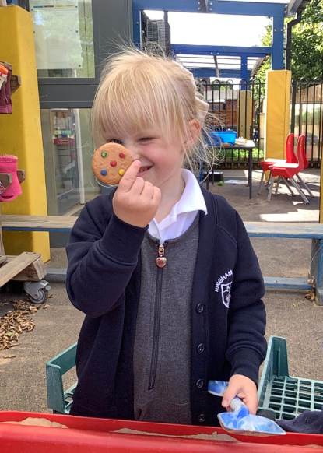
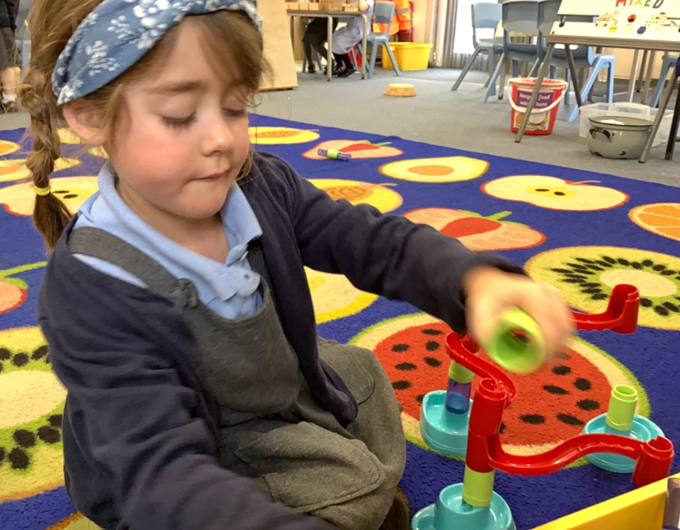
Butterfly Class Newsletter
11.09.26
It has been a fantastic week in Butterfly Class. It has been great having the children in altogether and getting to know them all better. They have been enjoying getting out onto the field at lunchtime and have been interacting with the rest of the school. They have been doing so well that sometimes it’s felt like they’ve been here for weeks already, you would not know it’s their very first full week at school. Well done Butterfly Class!
Named clothing:
We try our best to keep a track of everyone’s belongings but please make sure everything is labelled as this makes it much easier to return things to their owner. We’ve had a few jumpers already without names.
Communication folders:
Please make sure the communication folder goes into the green box each morning. We check the books everyday so if the book isn’t in the box we won’t see any messages inside.
Helmets and Wellies:
We are still missing a few wellies and helmets. We are out on the field in all weathers so named wellies are an essential and without a helmet children will be unable to go on the bikes.

