Slide 1
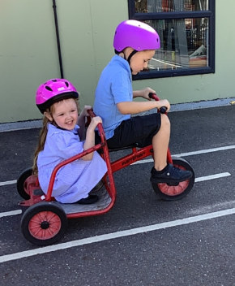
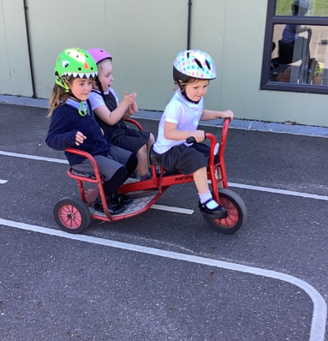
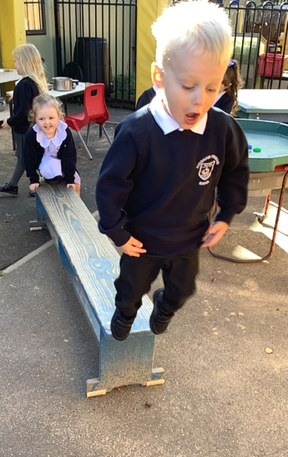
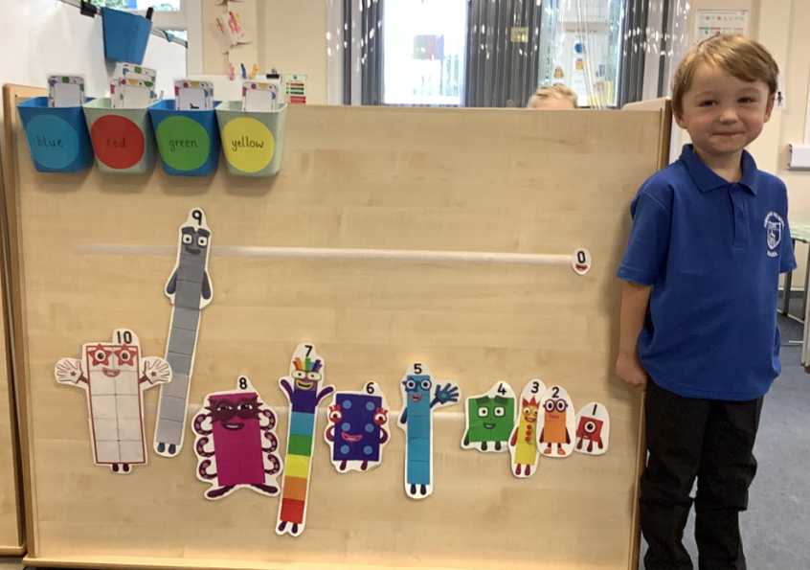
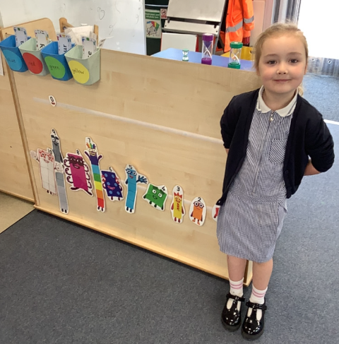
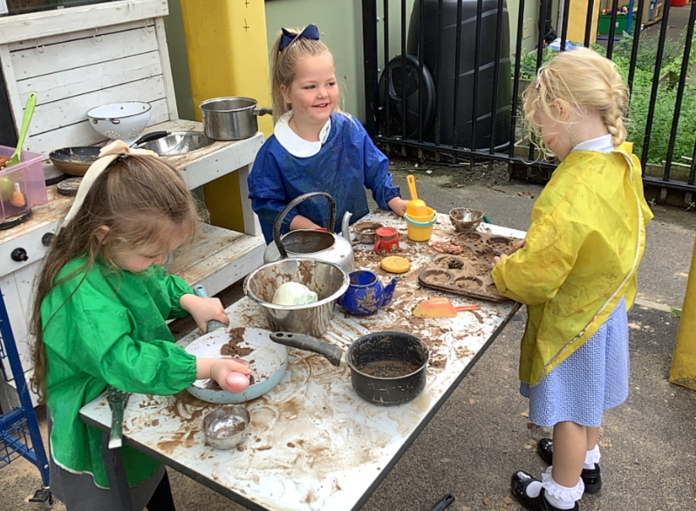
Butterfly Class Newsletter
18.09.26
We’ve had another busy and exciting week in Butterfly Class. This week the children had a go on the bikes (which they had all been desperate to do). We will be using these frequently so if you do take your child’s helmet home please return it to school so they don’t miss out. The children have started to feel more confident in school routines this week and it’s been lovely to watch them playing together and inventing lots of new games. Well done Butterfly Class! Keep up the good work!
Snacks:
We are a nut free school so please make sure children only have fruit or vegetables for morning snack. Please nothing that comes from a packet to ensure we can keep everyone safe.

