Slide 1
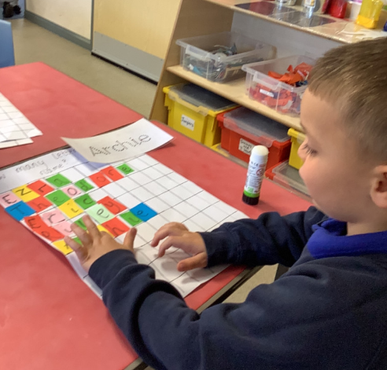
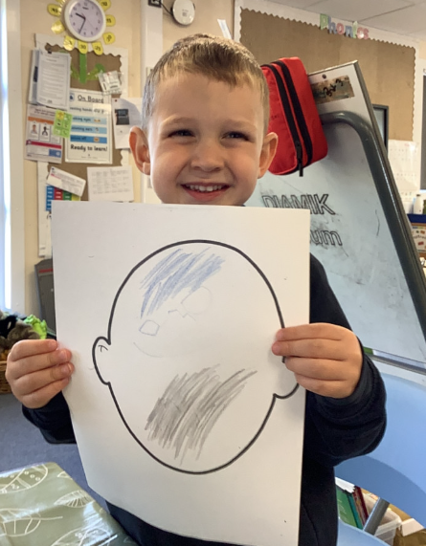
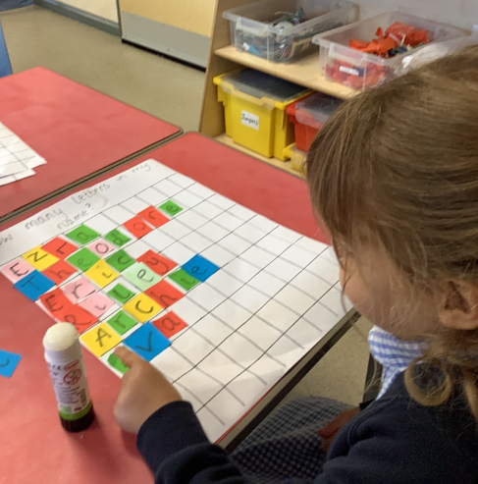
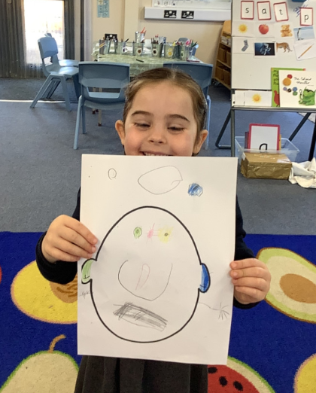
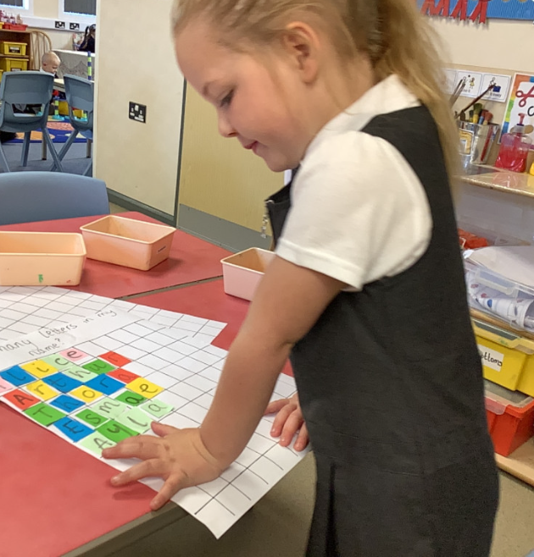
Butterfly Class Newsletter
25.09.26
It has been another busy and fun filled week in Butterfly Class. We are so impressed with how quickly the children have started joining in with the wider school during playtimes and lunchtime. It is such a joy to see. This week we have been looking at different emotions, the children had a go at pretending to be happy, sad, angry and worried. As a school we use the zones of regulation to help children understand and manage their feelings. If you would like more information about this approach please see the link Self-Regulation Curriculum | The Zones of Regulation. This week we have also been working on name recognition and thinking about how many letters our names have. The children have been starting to write their names independently using the correct letter formation. Keep it up Butterfly Class, the whole school are very impressed with how well you are all doing.

