Slide 1
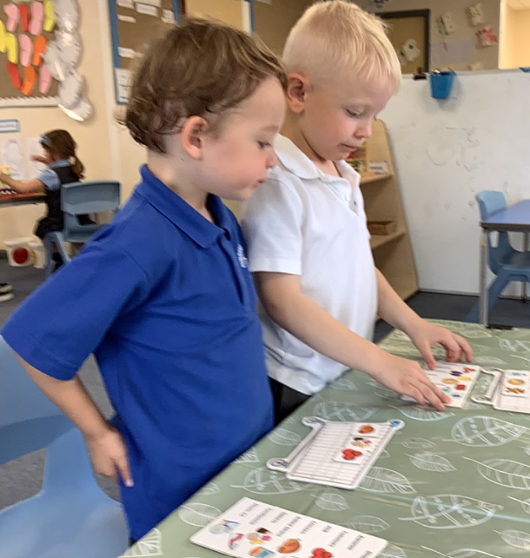
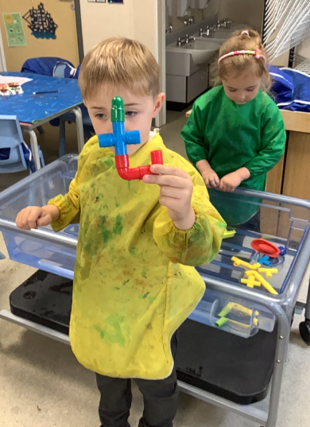
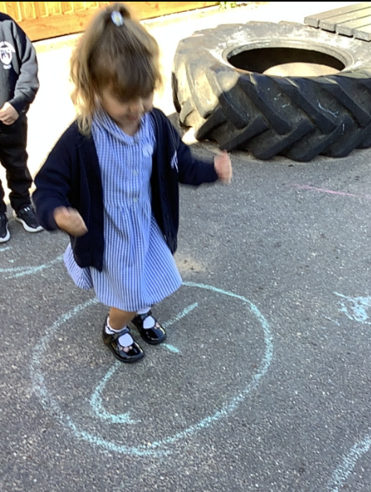
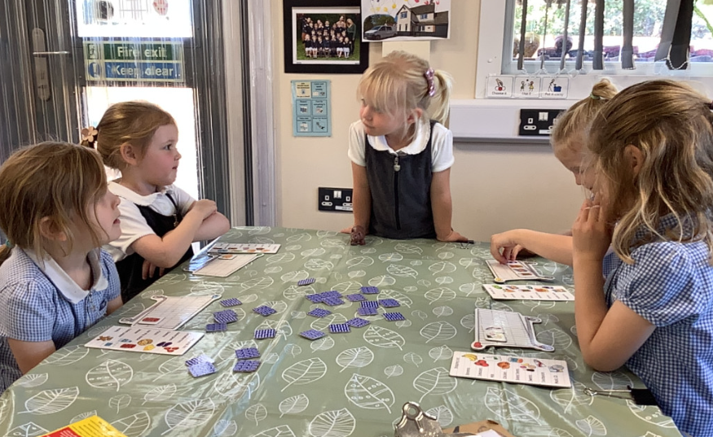
Butterfly Class Newsletter
02.10.26
This week in Butterfly Class we have been thinking lots about our families and how no two families are the same. The children have been making their own family trees and talking to us about who lives in their house. It has been lovely to get to know more about the children. We have also been playing games with the children that involve turn taking and sharing.
Practising sounds:
Please keep practising the sounds at home with your child. This really helps with their development in reading. Please record any practising in the communication book and we will find them a sticker.
Name cards:
Children came home with their name card on Thursday. We have been practising name writing at school and thought these might be useful to have at home in case the children want to continue this at home.

