Slide 1
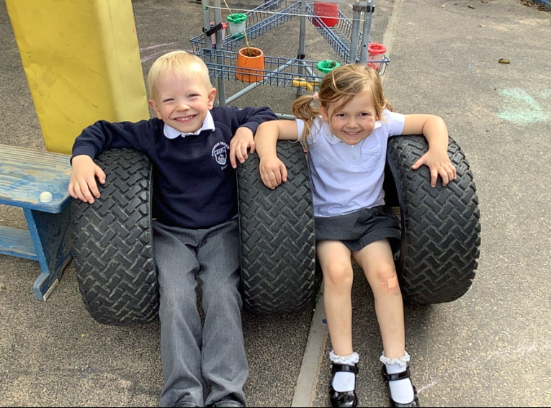
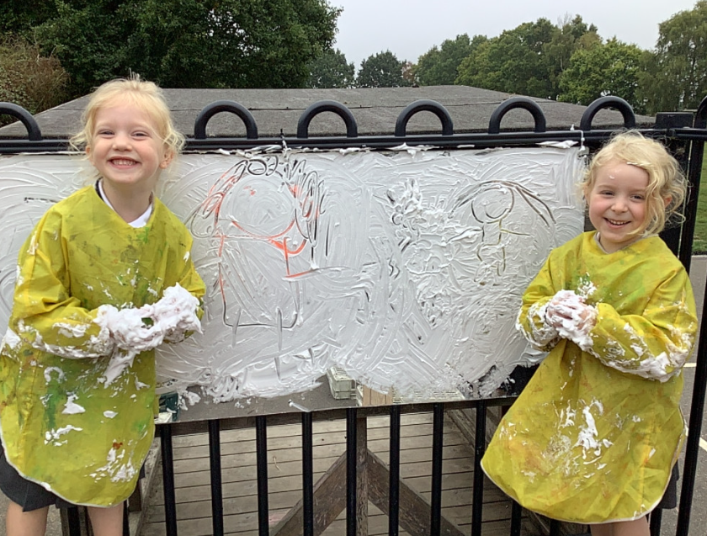
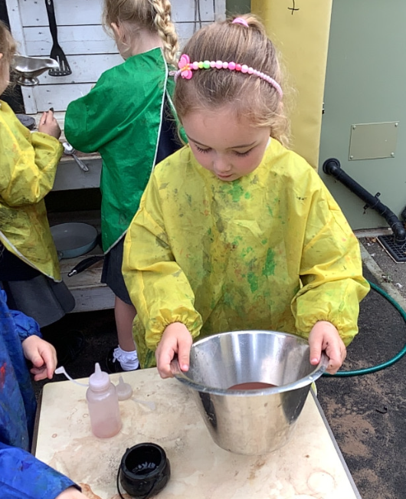
Butterfly Class Newsletter
09.10.26
We’ve been making the most of what might be the last of the good weather this week. We have spent lots of time outdoors making various different creations from potions, seesaws and masterpieces from shaving foam. We have also been learning how to sort different objects. The children have been sorting different types of food, themselves and different groups of objects. Another fabulous week!
EDP Photo:
Wednesday 14th October. We will have our class photo in the EDP’s First Class supplement. Don’t forget to go out and get yourself a copy as a keep sake.
Encouraging independence:
We are unfortunately approaching weather that is going to need us to have coats all the time. We are trying to encourage children to be as independent as possible in putting on and zipping up there own coats. I know getting out of the house can be challenging in the morning but when possible please allow your child to have a go at putting on their own coat.
Practising sounds:
Please keep practising the sounds at home with your child. This really helps with their development in reading. Please record any practising in the communication book and we will find them a sticker.

