Slide 1
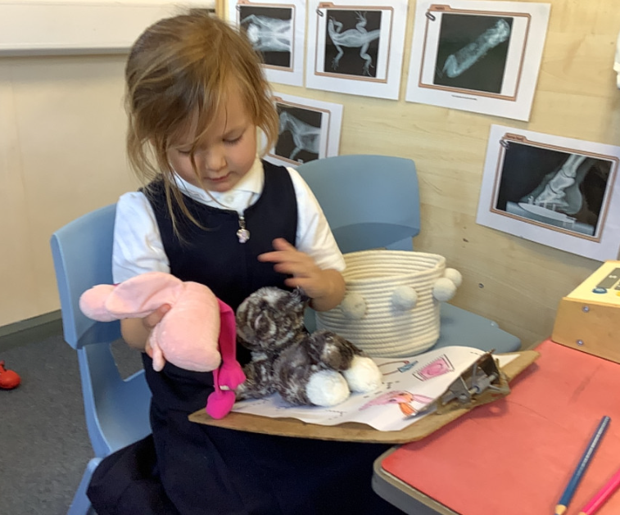
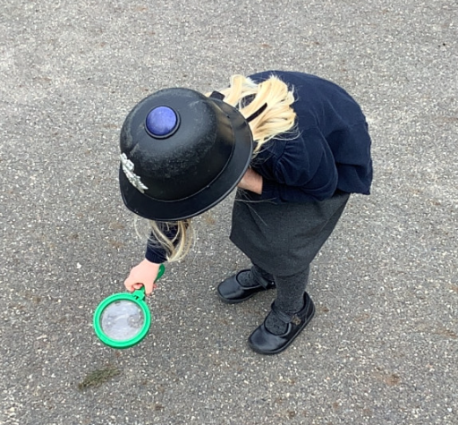
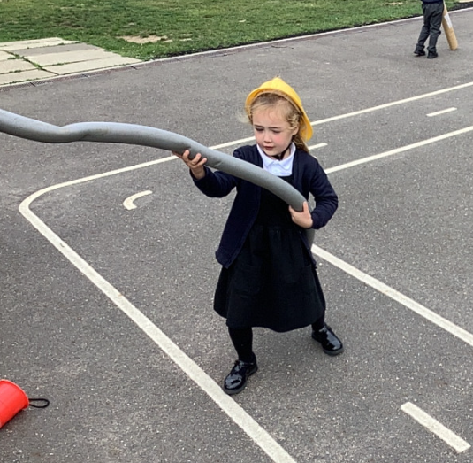
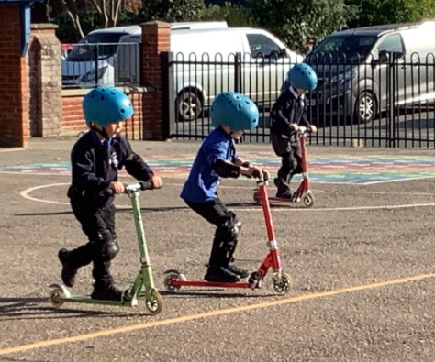
Butterfly Class Newsletter
16.10.26
It’s been another extremely busy week in Butterfly Class. This week we have been learning about people who help us. We have been thinking about the different things that the emergency services do to help us and how we would get there help if we ever needed it. The children also had their first scooter session on Wednesday. We were all very impressed with their resilience, as some of the children found using two wheels quite tricky but they kept going and didn’t give up!
Encouraging independence:
We are unfortunately approaching weather that is going to need us to have coats all the time. We are trying to encourage children to be as independent as possible in putting on and zipping up there own coats. I know getting out of the house can be challenging in the morning but when possible please allow your child to have a go at putting on their own coat.
Practising sounds:
Please keep practising the sounds at home with your child. This really helps with their development in reading. Please record any practising in the communication book and we will find them a sticker.

