Slide 1
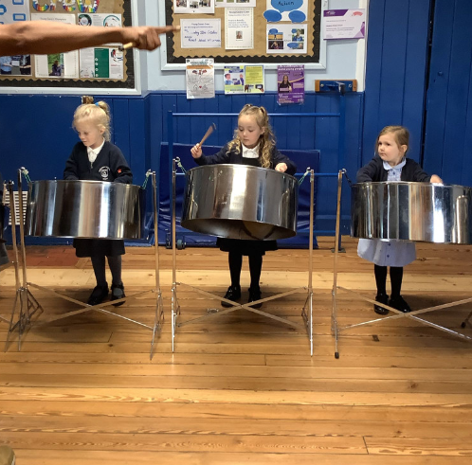
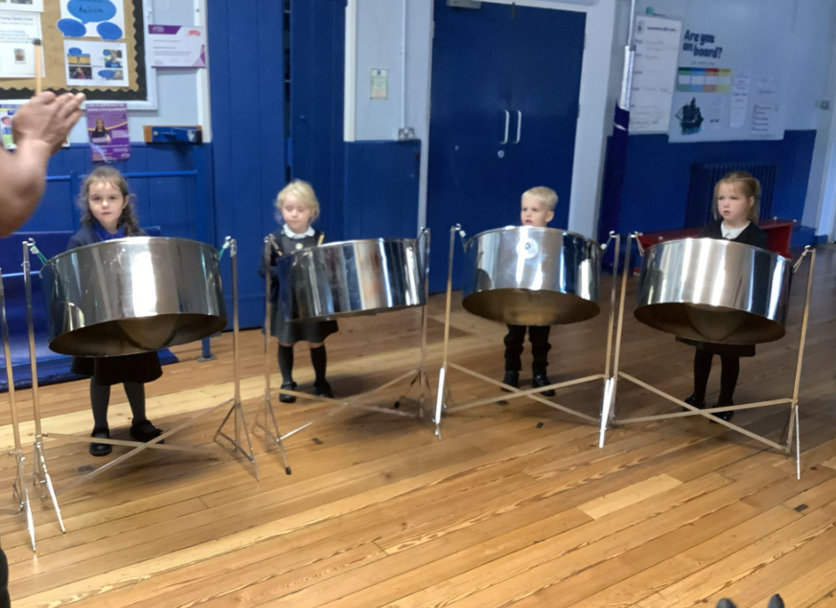
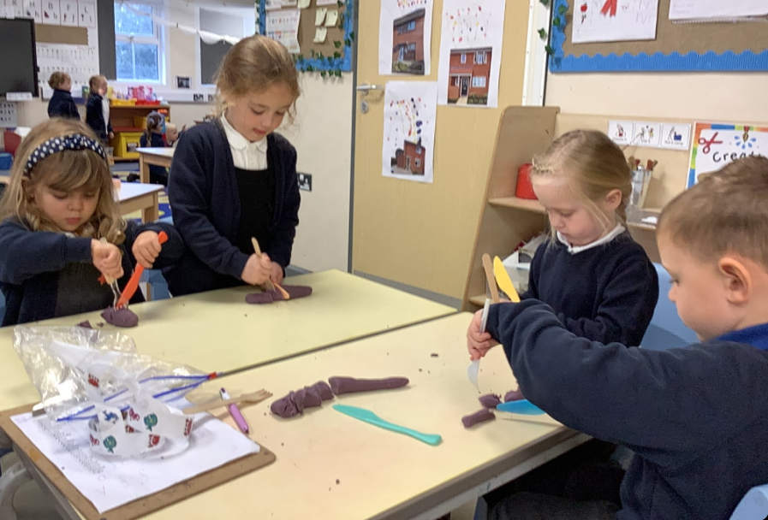
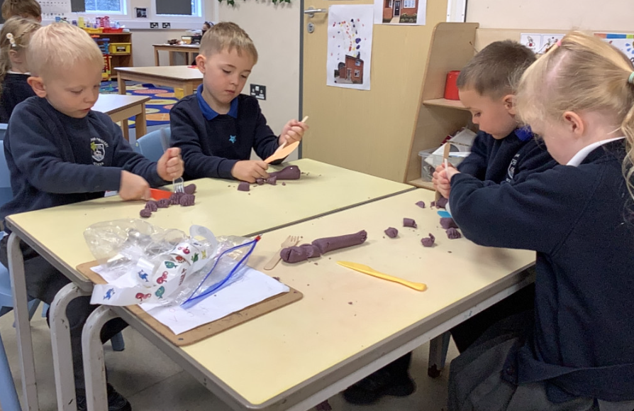
Butterfly Class Newsletter
22.10.26
It’s been another busy week in Butterfly Class. The children had a go at playing the steel drums on Monday. They listened incredibly well to the instructions and were able to play some music as a group. We also enjoyed listening to our visitors play some familiar songs on the steel drums as well.
What a half term it has been! We cannot get over how well the children have settled into school and we are looking forward to seeing what the rest of the year has in store. Have a wonderful half term.
Practising sounds:
Over half term please keep practising the sounds at home with your child. The cards can also be used to make 3 letter words for children to have a go at as well. Please record any practising in the communication book and we will find them a sticker.

